Slide 1

Harnessing health data for patient and public benefit
TwICs and big data
Tjeerd van Staa
University of Manchester

Slide 2

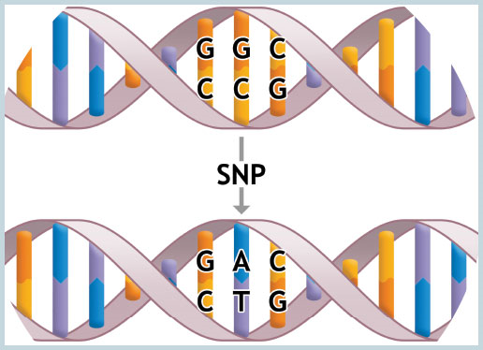

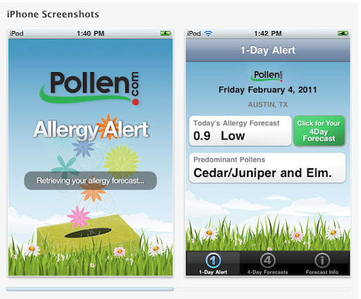
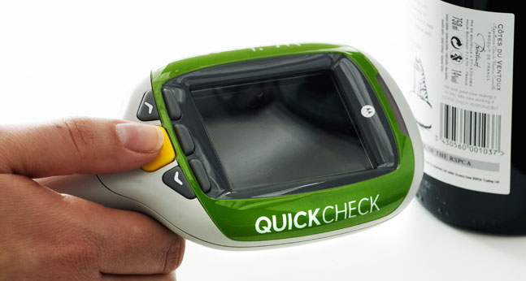
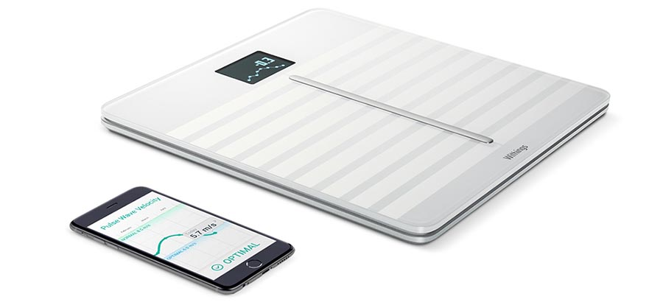
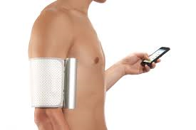
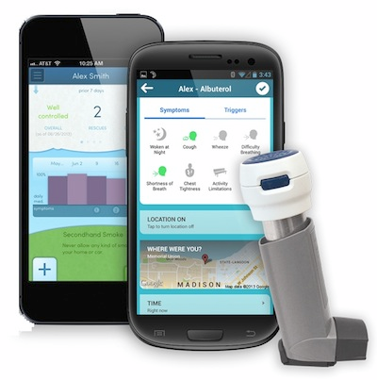
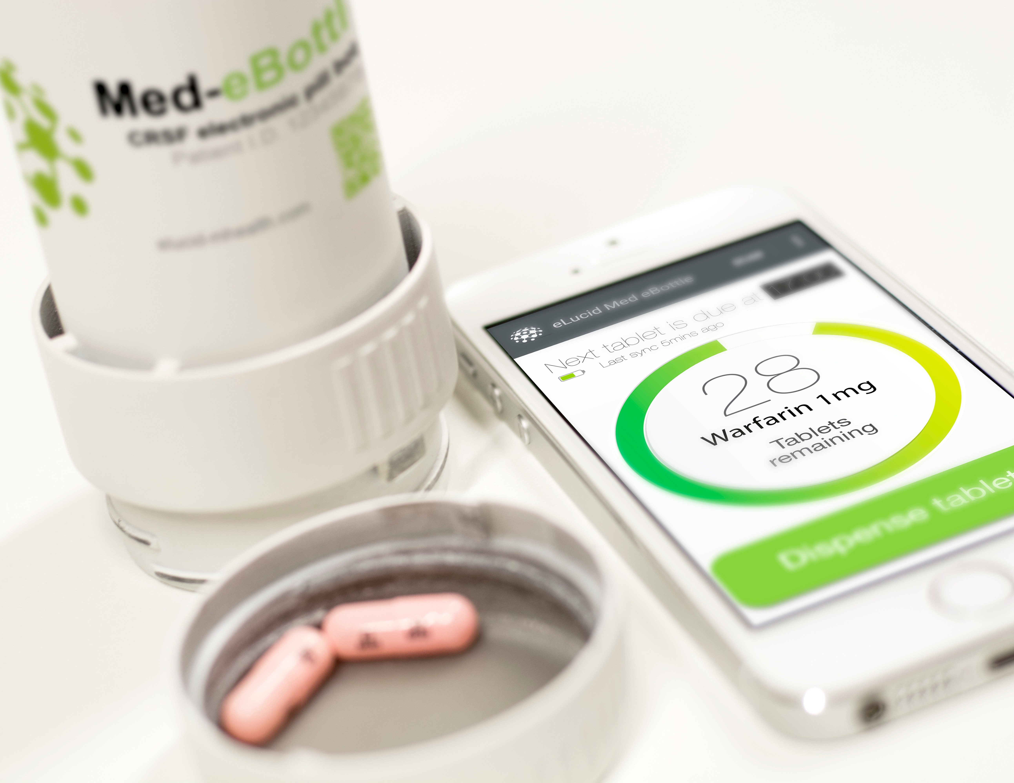

Slide 3

Primary Care: Historical Care Data Nexus
UK: From 1980s
NHS resource gatekeeper
Systematic paper-based
GP software engineers
Rationalisation and record transfers 1990s
World: 2016+
GP records on phone
SMS txt BP to GP
Phone/web consultations
Citizen data-controller, block-chain technology, distributed analytics
1988 AAH MEDITEL advertisement courtesy of Tim Benson

Slide 4
Explanatory and pragmatic trials
  Explanatory efficacy trials
    Can it work?
    To verify the biological effects of molecule
      Randomisation
      Close monitoring / selection
      Blinding / comparator often placebo
  Point-of-care (pragmatic) effectiveness trials
    Does it work?
    To compare different clinical strategies in actual practice
      Randomisation
      Replicate actual clinical practice for selection, monitoring and follow up
      No blinding / comparator standard care
Schwartz and Lellouch J Chronic Dis. 1967 Aug;20(8):637-48.
Notes:
Explanatory trials => to verify a biological effects of e.g. molecule – study population well adapted to the problem at hand, homogeneous and low withdrawal rate, blinding
-essential to establish biological effects
Pragmatic trials => to compare different clinical strategies - trial should represent / replicate actual clinical practice

Slide 5
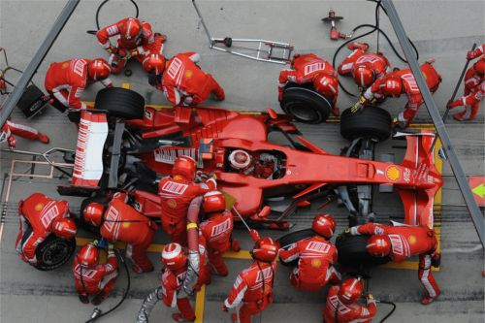
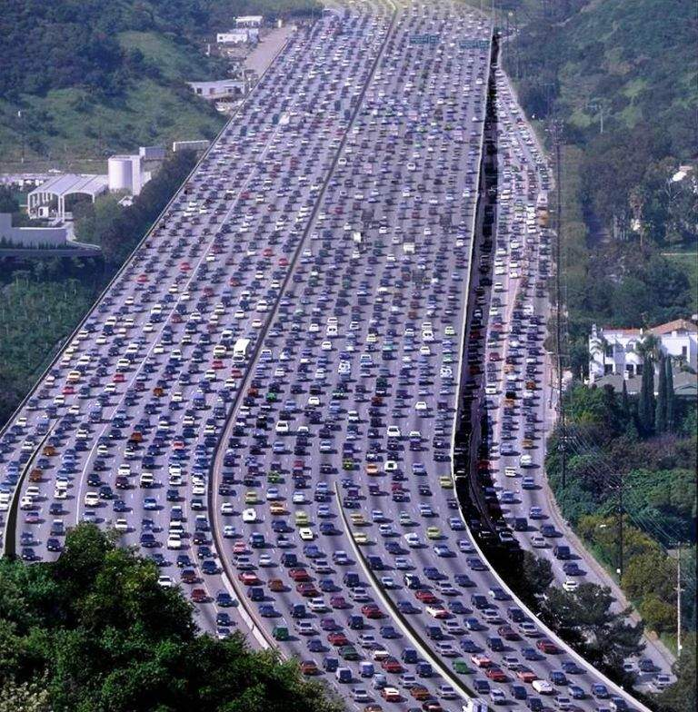

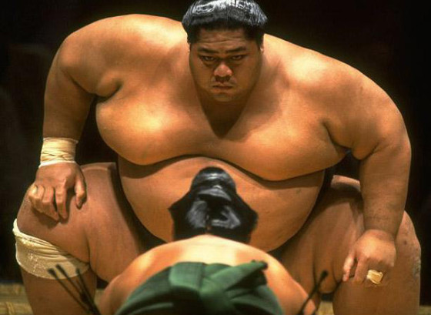
Pragmatic versus explanatory trials

Slide 6
Trials increasing complex and expensive:
What to do?
J Wisely (head ethics committees England): “Everyone, particularly individuals responsible for healthcare systems, can help to improve the efficiency of clinical research by promoting integration of research in everyday clinical practice”¹
Vickers [Clinical trials are in crisis]:
  Dramatically reducing eligibility criteria
  Use and improve routinely collected data
  Simpler designs
  Simplified / early consent
1. http://researchwaste.net

Slide 7
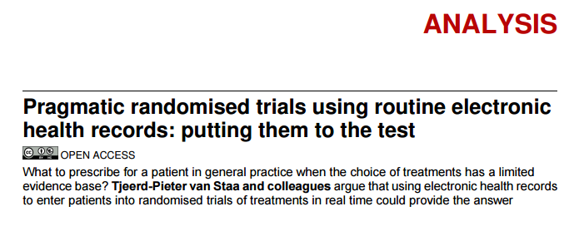
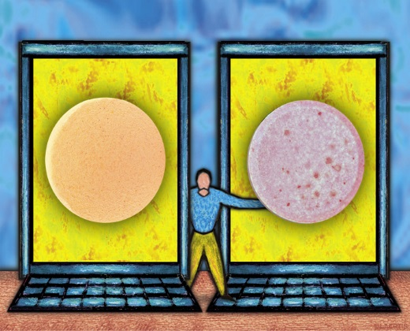
Van Staa TP et al. BMJ. 2012 Feb 7;344:e55. doi: 10.1136/bmj.e55.

Slide 8
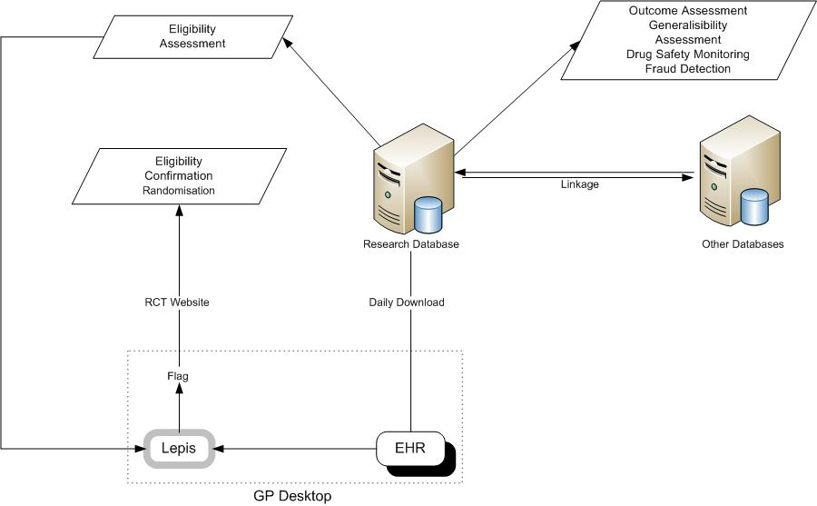
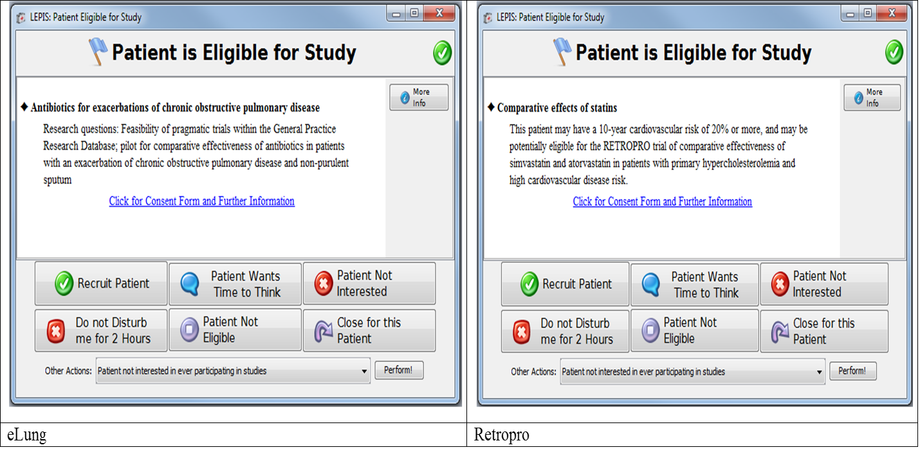
Example of data flow in pragmatic trials
van Staa et al. The opportunities and challenges of pragmatic point-of-care randomised trials using routinely collected electronic records. Health Technol Assess. 2014 Jul;18(43):1-146. doi: 10.3310/hta18430.

Slide 9


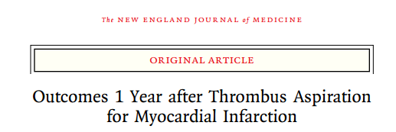
All-cause mortality up to 1 year
HR up to 1 year 0.94 (0.78 – 1.15), P=0.57
HR up to 30 days 0.94 (0.72 - 1.22), P=0.63
Lagerqvist B et al. N Engl J Med 2014; 371;12

Slide 10
Trials that use routinely collected data:
Challenges
Quality of data
  Adjudication of outcomes / develop and test case algorithms prior to trial
Completeness of data
  =>Evaluate prior to start trial and e.g. only select sites with better/complete data
Linkage to e.g. hospital data / death certification for long-term follow-up
Blinding
  Difficult in pragmatic trials + needed for hard outcomes??
  PROBE design
Representativeness

Slide 11
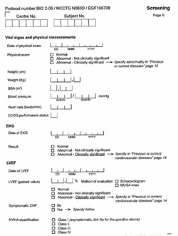
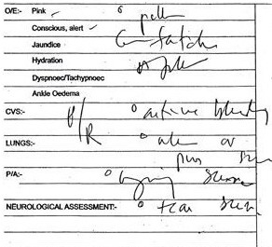
Data collection: Today

Slide 12

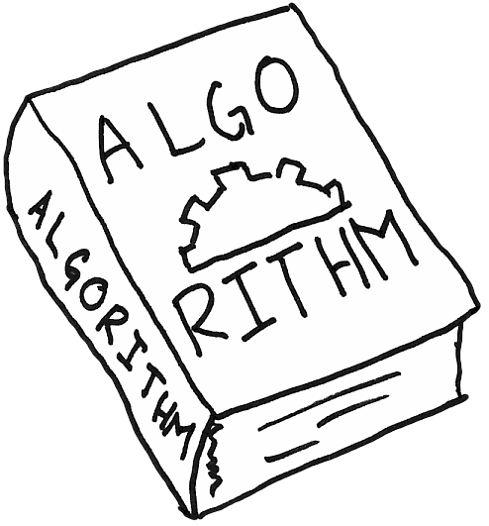
Data collection: Tomorrow
=>

Slide 13
Trials within cohort design using routinely collected data
Benefits
  Usual care=usual care (no Hawthorne effect in control)
  Pragmatic / efficient
  No disappointment being randomised to old treatment
Challenge
  Treatment refusal only present in intervention arm, which can lead to bias
  Heterogeneity in control arm
  Inception / prevalent users
  ‘Unethical’ for lack of consent to usual care / ‘guinea pig’
Large group of patients
Random selection of patients offered novel intervention
Eligible patients

Slide 14
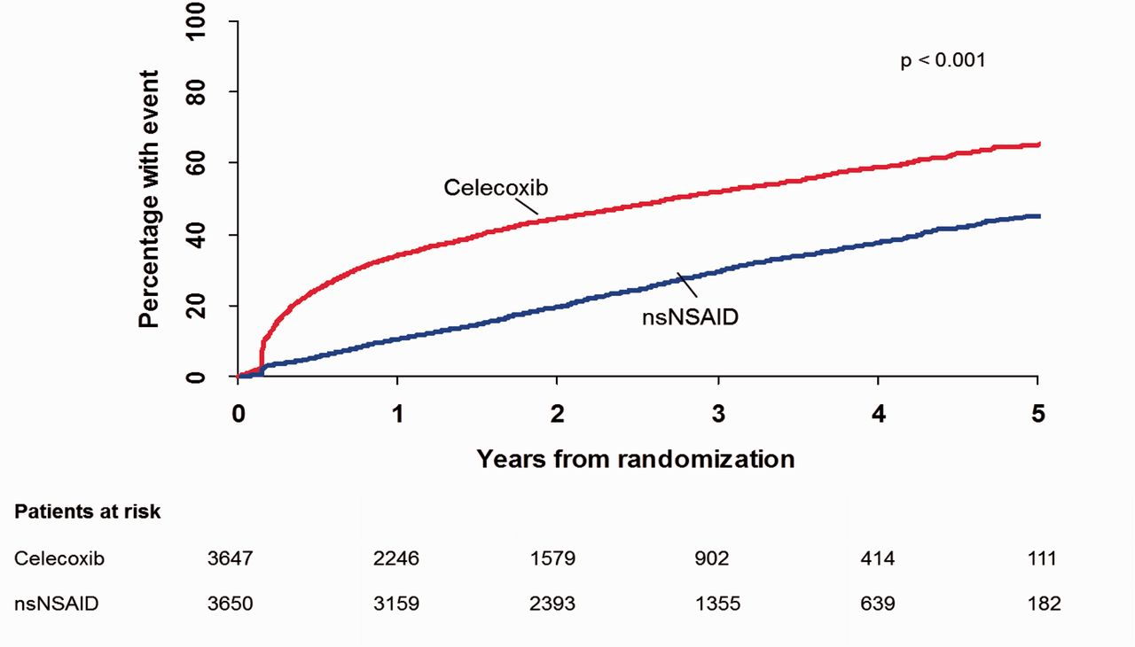
Standard care vs. Celecoxib Outcome Trial (SCOT) Eur Heart J 2016

Slide 16
Disadvantages of trial design
Treatment refusal happens:
  Only in the intervention arm
  Post randomisation
Bias
Power
Notes:
Explain the issue of refusal
Bias:
Cant exclude these patients from the analysis as you would do in a usual trial, as then two arms would be incomparable
Power:
- Refusal effects power so to pre power trial unless refusal rate must be known

Slide 17
Bias and loss of power

Slide 18
Bias and loss of power - conclusions
The ITT effect in routine practice is likely to lie somewhere between the ITT and IV estimates from the trial which differ significantly depending on refusal rates.
More research is needed on how refusal rates of experimental interventions correlate with refusal rates in routine practice to help answer the question of which analysis more relevant.
We also recommend updating the required sample size during the trial as more information about the refusal rate is gained – adaptive sample size.
Notes:
Unlike dropout in a usual trial, this refusal happens at recruitment and so can be completely nullified (no need to try to estimate refusal and then be left with an under or overpowered study)
If cohort is really big, this is not such an issue. If cohort is smaller then simulations should be ran to test different refusal scenarios (in both cmRCT and the standard RCT), to see which is more powerful

Slide 19
Heterogeneity in RT
Comparing Treatments
Vs Vs
=
Unobserved Confounding and Unobserved Heterogeneity are problems
Comparing Treatment
Vs
=
Unobserved Heterogeneity is a problem
New Treatment
Control Treatment 1
Control Treatment 2
New Treatment
Control Treatment

Slide 20
Pragmatic Trials
Example of Pragmatic Trial: Salford Lung Study
Our Primary interest: binary outcome
New treatment to be compared with existing treatments (heterogeneity in the control arm)
Confounding is a problem. Usual methods to adjust for observed confounding are:
  Multivariable Logistic Regression, corrected for confounders
  Propensity Score
  Disease Risk Score
  Inverse Probability Weighting
  Doubly Robust Inverse Probability Weighting
  Standardization

Slide 21
Simulation Study
Scenario 1: 10000 patients, 10000 replications, β=1, γ=1, Obs: α=1, UnObs: δ=0

Slide 22
Simulation Study
Scenario 2: 10000 patients, 10000 replications, β=1, γ=1, Obs: α=1, UnObs: δ=1

Slide 23
Conclusions
TwICs design very suited for pragmatic trials + era of big data (ubiquitous data collection)
Challenge is bias and loss of power due to non-uptake of new intervention
  Adaptive power calculations
  If large non-uptake, consider switching to standard trial
Challenge is heterogeneity in usual care
  Comparison with individual control treatments may be biased

