Slide 2
How do TWICs trials fit into Pragmatic/Explanatory framework? Merrick Zwarenstein Ethics of TWICS workshop
London UK November, 2016
Notes:
I am delighted to be at another workshop on TWICS trials, and really happy to have the chance to think about the relationship between TWICs trials and the pragmatic explanatory framework, PRECIS2.
Why think about TWICs in the context of the Pragmatic Explanatory trials framework?
I want to argue that far form being alternatives to each-other, the Pragmatic Explanatory framework applies to all types of randomized trials and thus allows us to understand TWICs better.
I think that this PRECIS 2 framework could help designers of TWICS trials make tactical choices to match their intentions to the chosen design tactics.

Slide 3
We are only talking about RANDOMISED trials
Notes:
Confusion has been created by use of the term pragmatic studies, non specific as to randomization.

Slide 4
Relationship between TWICs trials and Pragmatic/Explanatory framework
Three ways of categorising RCTs:
Attributes
Structures
Attitudes
Notes:
Since the first randomized trial there has been an explosion in their number (now over 400 000 published trials) but also, as any new technology matures, a profusion of derivatives of the simple parallel RCT design have developed to address problems in conduct or to adapt the design for these other questions, settings, uses.
I will explore the relationship between TWICs trials and Pragmatic or explanatory trials by comparing 3 ways of looking at RCT design.
I am calling these three different aspects of RCT design
Tactics
Structures
Intentions
We will start with a short description of pragmatic trials and the PRECIS 2 instrument for designing RCTs.

Slide 5
It is the thesis of this paper that most trials are inadequately formulated. Their inadequacy is basic, in that trials may be aimed at the solution of one or other radically different kinds of problems.
Notes:
The concepts underlying the Pragmatic Explanatory Continuum Indicator summary are based on
Schwartz and Lellouch, two French statisticians who pointed out that there are TWO VERY DIFFERENT purposes to which a trial can be adressed.

Slide 6
A Spectrum Of RCT’s: Pragmatic Versus Explanatory Attitudes to RCTs
Pragmatic: Aimed at a decision
Which intervention should we prefer?
Community-oriented answer will tell us whether drugs, when offered by a wide range of clinicians, to patients who might or might not take it, and causing an acceptably low risk of adverse drug effects, do more good than harm
Explanatory: Aimed at understanding causal relationships
Does a difference in outcome relate to intervention?
Biologically-oriented answer will tell us whether drugs, when prescribed by experts, taken faithfully by patients, exhibiting their full pharmacodynamic effects…. do more good than harm.
Notes:
First, S and L described this distinction as an attitude to the purpose of a trial.
Pragmatic trials are aimed at providing evidence to support a (clinical) decision.
Explanatory trials at understanding a mechanism of action by confirming a causal hypothesis
This was not described as a dichotomy,
Instead it was viewed as a spectrum.
Im going to focus on how their work was interpreted by Dave Sackett, for clinical trials.

Slide 7
Sackett 2005
 | Explanatory Trial (Efficacy) | Pragmatic Trial (Effectiveness, Management)
1. Nature of the question posed | Can the Rx work under ideal circumstances (of risk, responsiveness, compliance, and follow-up)? | Does the Rx work under usual circumstances?
2. Patient eligibility criteria | Very strict, limited to high-risk, responsive, highly compliant patients. | All comers with the target disorder.
3. Patients subsequently found to be ineligible at entry | Excluded from the analysis whenever it is valid to do so. | Usually included in the analysis.
Practihc Basic Workshop - Overview
Notes:
Presented as binary

Slide 8
Sackett 2005
 | Explanatory Trial (Efficacy) | Pragmatic Trial (Effectiveness, Management)
4. Treatment | Given by the best hands and closely monitored for dose and side-effects. | As in routine clinical care.
5. Intensity of follow-up | High, with frequent visits. | No greater frequency than in routine practice.
6. Patient compliance | Closely monitored, with compliance-maintaining/improving strategies for all patients. | May be monitored unobtrusively , but no interventions.
7. Clinician adherence to the study protocol | Closely monitored, with feedback for incomplete performance. | Little or no monitoring.
Practihc Basic Workshop - Overview

Slide 9
Sackett 2005
 | Explanatory Trial (Efficacy) | Pragmatic Trial (Effectiveness, Management)
8. Events of interest | Restricted to just those that answer the biologic question (or constitute adverse effects of treatment). | All relevant important events, regardless of their causes.
9. Duration of follow-up for individual participants | Stops (“censored”) as soon as they have the event of interest. | Continues to the death or the end of the trial, whichever comes first.
10. Eligibility of events for analyses for “benefit” | Restricted outcomes, excluding those occurring before the Rx “takes hold” and after Rx has been stopped, or contaminated. | All outcomes, from the instant of allocation, through treatment, to the close of the trial.
Practihc Basic Workshop - Overview

Slide 10
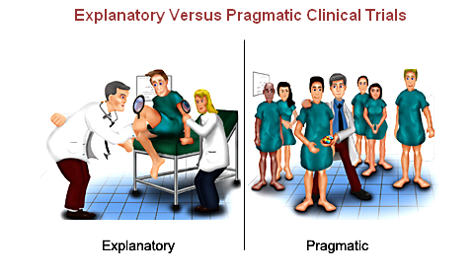
Practihc Basic Workshop - Overview
Notes:
Illustrated by this cartoon- which shows differences in
Ratio of trial staff to patients
Specialised trial setting vs usual practice
Heterogeneity of patients
Intensity of testing and monitoring

Slide 11
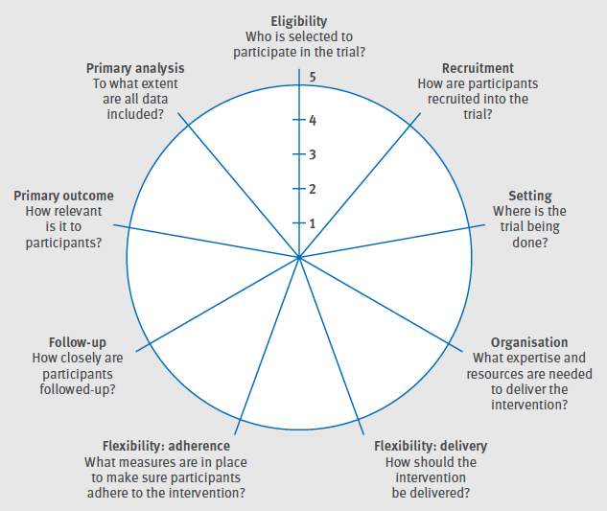
The PRECIS-2 tool: designing trials that are fit for purpose
Loudon K, Treweek S, Sullivan F, Donnan P, Thorpe KE, Zwarenstein M.
BMJ 2015;350:h 2147 doi: 10.1136
Notes:
During her dotoral degree, Dr Kirsty Loudon developed a tool for operationalizing the Schwartz and lellouch concepts of pragmatism and explanatoriness.
This was an imporvement on the first PRECIS tool, published in 2009.
Its intended mainly for use by teams who are designing an RCT
so that the tactical choices made match the desired attitude of the trial.
One criticism is that PRECIS 2 is better at assisting teams to think about how to design a trial towards the proagmatic end of the spectrum than to the explanatory end.
It has also been used to evaluate published trials and trial protocols, as it were, retrosepctively.
This is how we have validated the tool, using these retrosepective studies.
There are nine domains.
Eligibility, who is included and excluded. (Participants/Patients/Groups…..)
Recruitment: Are participants recruited in a way which matches usual care in that setting.
Setting: Is the trial being done in a typical setting, ie as per where it would be used should intervneiton be shown to be effective.
Organistion: Is organisation of care delivery similar to what it might be in the future : are trial resources added, eg for screening, adherence, treatment etc.
Felxibility- deliveryAre clinciians restricted, selected ro trained or monitored in any way?
Flexibility-adherence- Is participant adherence monitored or controlled beyond what will be done in usual care setting
Follow up- Are participants followed up more closely that in usual care.
Primary outcome relevant to participants- mortality, severe morbidity, validated QOL (vs biological , serum biochemistry).
Primary analysis ITT?
The main changes from PRECIS 1 are that PRECIS 2 assumes that the trial is a parallel arm trial, and that the comparator is usual care.
If this is not so, or if there are multiple arms, we recommend using multiple PRECIS-2 diagrams for displaying design tactics.

Slide 12
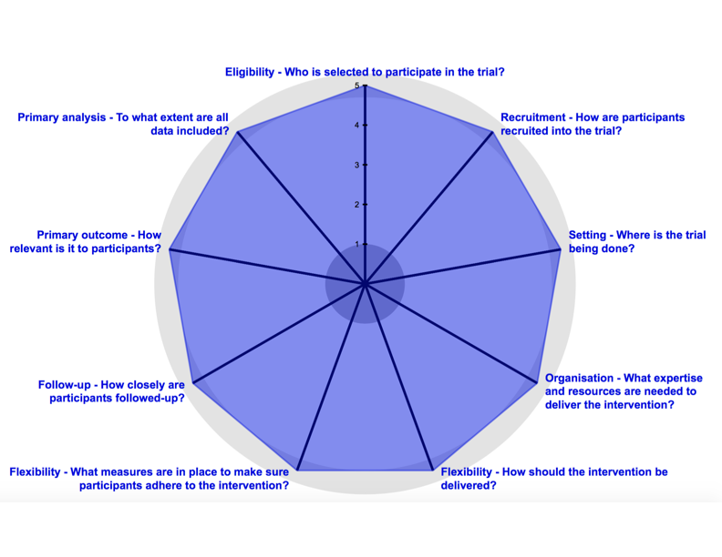
PRECIS-2 Diagram: GISSI Study
Notes:
First large trials of intravenous streptokinase 1.5 million units for thrombolysis in myocardial infarction –
GISSI trial with 11 806 patients reported in February 1986 and the ISAM trial with 1700 patients June 1986
Eligibility- All patients admitted within 12 h after reported onset of symptoms, if no contraindications to streptokinase. > 60% of all eligible patients recruited 12 000
Treatment - Usual care vs usual care plus streptokinase , no blinding for control group, ie no infusion.
Recruitment- usual flow of care, consent waiver
Setting- Multicentre in Italy only. over 90% of coronary care units participated
Organisation- Minimal data collection allowed for randomization by usual clinician, no extra resources for treatment.
Flexibility: No changes to usual care processes except infusion
Flexibility: Patient adherence- No monitoring, no changes (but single infusion)
Primary outcome:Mortality at 21 days
Primary Analysis >99% included in analysis
Result 18 % reduction in mortality, p= 0. 0002 (3 zero’s)
The ‘pragmatic’ study takes all-comers, from almost all possible sites in an entire country where the treatment could be offered, allows patients to be treated as would be habitual at those sites of care. The trial shows a distinct benefit in an important, patient-relevant outcome (and because of its huge size is able to use subgroup analysis to show that the window of effectiveness is narrower than the inclusion criterion). By simplifying the inclusion and data collection processes, the trial could be made enormous, with tight confidence intervals around the estimates of this important effect. The trial was prominently published in the Lancet and frequently cited in later discussions of intravenous streptokinase treatment. This trial may well have changed practice globally, as was its explicit intent: “to test in a formal prospective trial whether effective and safe thrombolysis could be achieved with intravenous streptokinase under routine conditions in the majority of patients…”

Slide 13
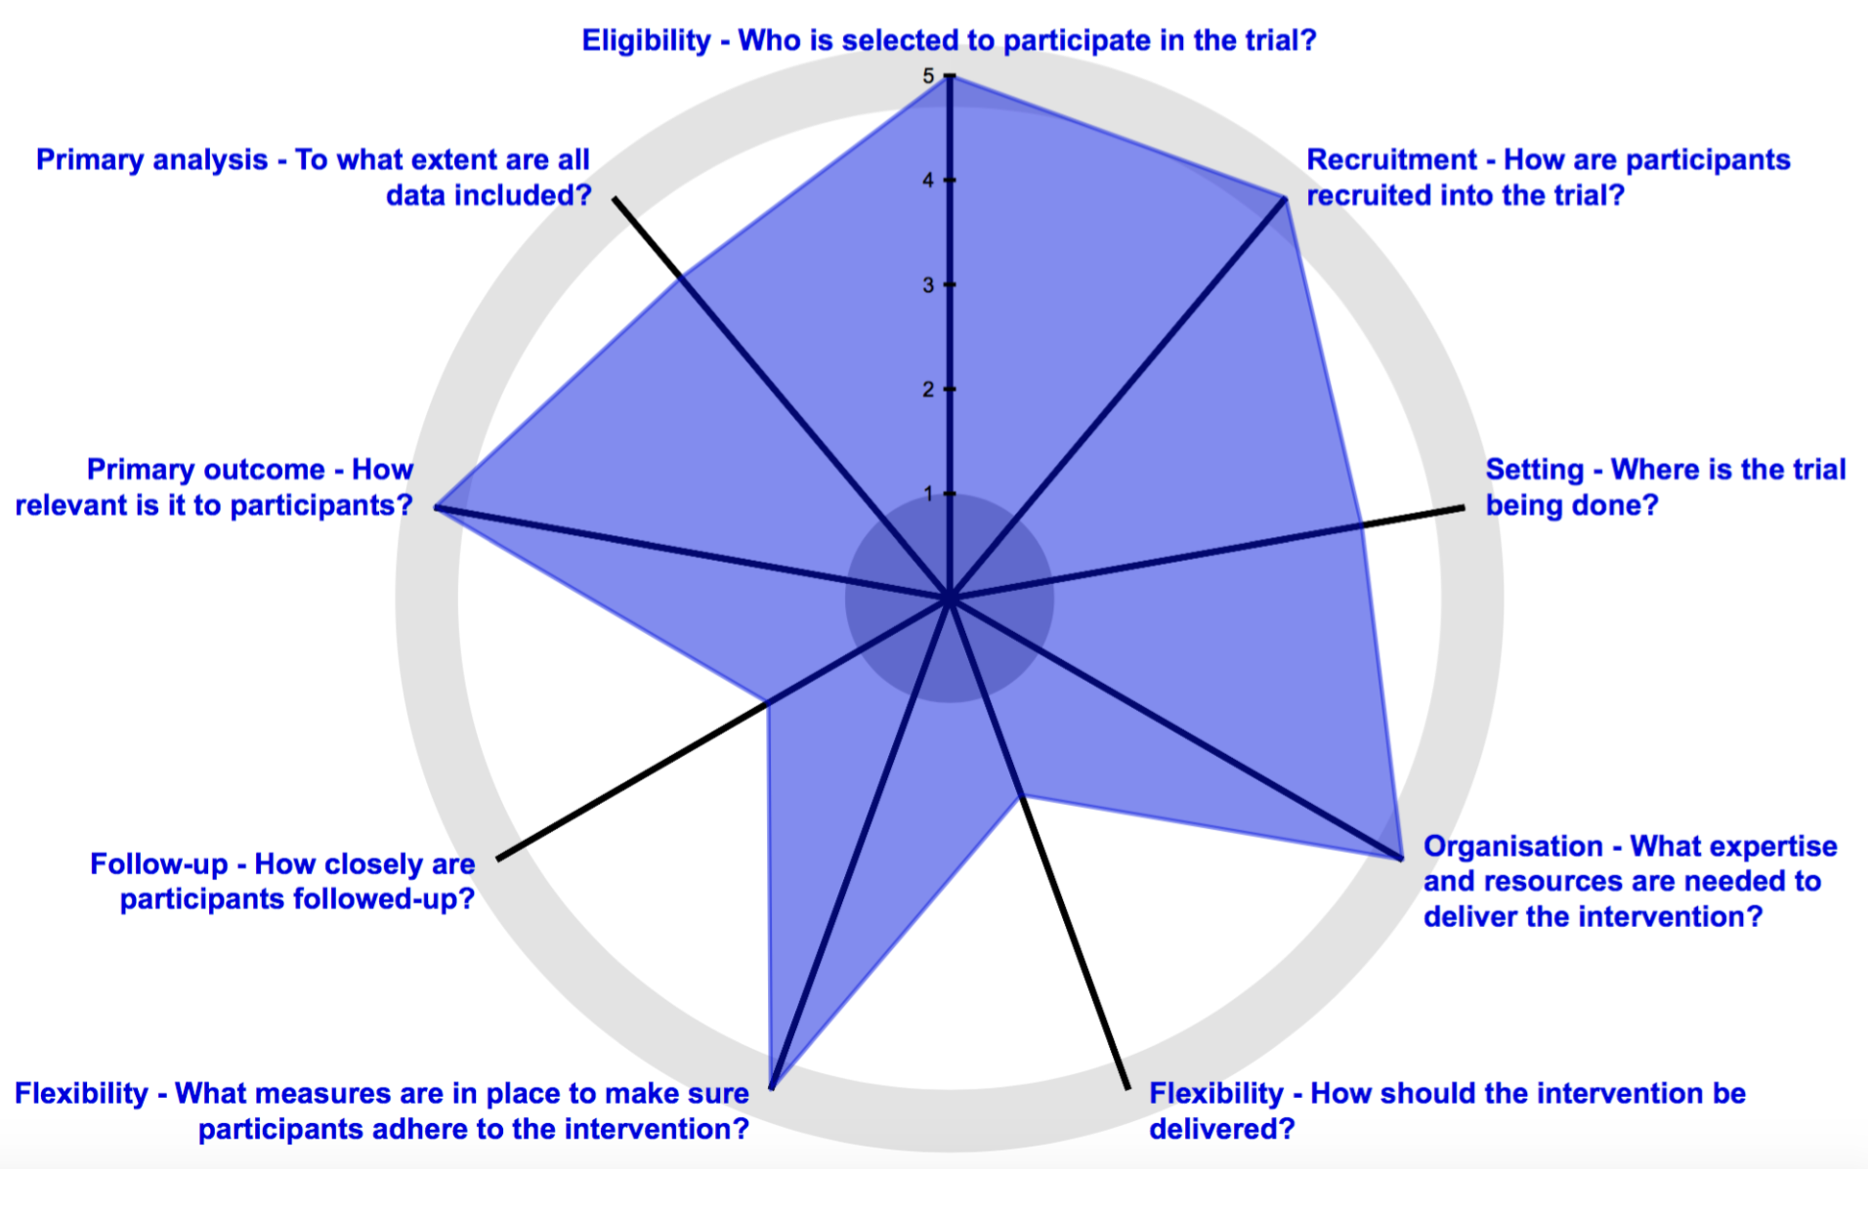
PRECIS-2 Diagram: ISAM study
Notes:
ISAM trial with 1700 patients June 1986
Eligibility- Patients 75 or less admitted within 6 h after reported onset of symptoms, if no contraindications to streptokinase. > 60% of all eligible patients recruited 12 000
Treatment - Usual care vs usual care plus streptokinase , blinding with identical placebo intervention.
Recruitment- Maximal data collection, full research team support for recruitment and for consent
Setting- Multicentre in US, Canada, UK, Germany . Only highly specialised coronary care units selected.
Organisation- treatment by usual clinician
Flexibility: No changes to usual care processes except infusion
Flexibility: Patient adherence- No monitoring, no changes (but single infusion)
Primary outcome:Mortality at 21 days
Primary Analysis >99% included in analysis
Result No statistically significant difference in mortality. Mainly reported the secondary outcomes especially enzyme indicating muscle damage to heart. Ie mechanism of action. And angiography on an available (and likely less severe) group of 848 survivor patients to measure ejection fractions. And in the final sentence of the paper, attention was drawn to the five patients with or suspected of having intracranial bleeds.
trial contributed little to clinical decision making
ISAM trial, combined an explicit primary outcome of mortality, almost ignored in the discussion, with an intense and costly focus on mechanism of action, resulting in a trial that was too small, yielding a difference in mortality that was not statistically significant, and was of little use in informing future clinical practice. Because the trial failed to show a clear benefit on mortality, the findings on the drug’s possible mechanism are moot.
The contrast between the two trials can be illustrated graphically (see Figures) using PRECIS – the Pragmatic Explanatory Continuum Indicator Summary (Thorpe et al. 2009) and the updated tool, PRECIS-2; (Loudon et al. 2015).

Slide 14
Most trials done hitherto have adopted the explanatory approach without question; the pragmatic approach would often have been more justifiable.
Notes:
Schwartz and Lellouch ended their paper…....
We should be doing more pragmatic trials.
This still seems valid

Slide 15
Relationship between TWICs trials and Pragmatic/Explanatory framework
Three ways of categorising RCTs:
Attributes
Structures
Attitudes
Notes:
How does this relate to the TWICs triald esign, which is, I think similar ot the registry trials?
Since the first randomized trial there has been an explosion in their number (now over 400 000 published trials) but also, as any new technology matures, a profusion of derivatives of the simple parallel RCT design have developed to address problems in conduct or to adapt the design for these other questions, settings, uses.
I will explore the relationship between all of these trial designs especially TWICs trials, and Pragmatic or explanatory attitude by thinking about the 3 ways of looking at RCT design.
I am calling these three different aspects of RCT design
Attributes
Structures
Attitudes

Slide 16
Typology of RCTs: Attitude
Explore mechanism of action ideal conditions
Efficacy trial
Mechanistic trial
Explanatory trial
Directly inform real world decisions
Effectiveness trial
Practical trial
Pragmatic trial
Notes:
S and L (and Michael Healey, who worked at the LSHTM, just down the road) first described the concept.
It is one of intention, the purpose of the trial, and they posit two ATTITUDES- pragamtic and explanatory
Pragmatic and explanatory attitudes represent two ends of a spectrum,
which ranges from pragmatic trials, deisgned to assist in choosing between treatment options,
and explanatory trials, designed to clarify causal relationships between an intervention and an outcome.
These two extremes are equivalent to the other two much less detailed concepts
- the mechanistic-explanatory trials and the efficacy effectiveness trials.

Slide 17
Typology of RCT designs: Attributes
Improve Efficiency
Factorial trials: Test multiple combinable independent treatments at once
Sequential trials: Evaluate treatment with as few participants as possible
Crossover trials: Maximise effective sample size in trials
Large simple trials: Simplify trial entry, increase trial size, detect moderate benefit
Platform and adaptive trials: Maximise use of patients, test multiple treatments
Individualise treatment effect estimate
n of 1 trials: Obtain randomized evidence in and for a single patient
Test an alternative statistical hypothesis
Equivalence/non inferiority trials: Confirm similarity of intervention effects
Evaluate Interventions aimed at groups
Cluster randomized trials: Evaluate interventions applied to groups
Integrate RCT within flow of care
Stepped wedge trials: Evaluate innovations during scale up in a health system
Registry trials/TWICs: Evaluate modifications in care of an established patient pool
Notes:
First is looking at the attributes of different RCT designs.
This list covers most of the RCT designs that have been given an adjective.
(show animations 1-9 only)
Think of these in comparison with the archetypal parallel arm RCT – what attribute does each of these specific design adaptations have?
(show animations 10-11-12-13)
As you can see, each adjectivally defined RCT design has a specific attribute- improved efficiency, group interventions…....
One is missing- the TWICs trial.
(shw animation 15)
And we also don’t see pragmatic or explanatory trials because the P/E issue is not about any specific tactic.

Slide 18
Typology of RCTs: Structure
Multiple Treatment/s
Factorial trials: Test multiple combinable independent treatments at once
Platform and adaptive trials: Maximise use of patients, test multiple treatments
Registry trials/TWICs: Evaluate modifications in care of an established patient pool
Comparator
Equivalence/non inferiority trials: Confirm similarity of intervention effects
Crossover trials: Maximise effective sample size in trials
Stepped wedge trials: Evaluate innovations during scale up in a health system Registry trials/TWICs: Evaluate modifications in care of an established patient pool
Unit of allocation
n of 1 trials: Obtain randomized evidence in and for a single patient
Cluster randomized trials: Evaluate interventions applied to groups
Sample size
Sequential trials: Evaluate treatment with as few participants as possible
Large simple trials: Simplify trial entry, increase trial size, detect moderate benefit
Registry trials/TWICs: Evaluate modifications in care of an established patient pool
Notes:
This second way of typing RCTs focused on the structure that the designer chooses- (to achievethese attributes.
(simultaneously show animations 1-4)
how they set up control and intervention groups, unit of allocation and recruitment of participants.
(show animation 5)
These 3 designs offer the opportunity for multiple interventions to be tested,
either simultaneously (factorial) or evolving within a single study (adaptive/ platform, or evolving between studies (TWICs)
I also think there is no reason why a TWICs trial couldn't’t be set up as an adaptive or platform trial,
combining the defined study population of a registry/cohort with the merits of preplanned adaptation as results accrue.
(show animation 6)
These three designs deal with the comparator differently-
the equivalence trials test for statistical equivalence, not superiority;
the crossover trials switch participants between intervention to comparator groups,
and the stepped wedge trials do this, also, but only in one direction.
(show animation 7)
The n of 1 trials allocate units of time not participants;
whereas the cluster trials allocate groups, not individuals.
(show animation 8)
These three use different ways of optimising sample size.
Sequential trials minimise the sample size by repeat testing,
Large simple trials maximise the sample size by simplifying recruitment,
and TWICs trials optimise logistics by drawing their intervention and the control groups from a predefined cohort.
Notice registry/TWICs trials appear three times, as the design adresses 3 structural innovations– allowing multiple treatments to be tested, comparators to be drawn from the pool, or equal to the pool, and sample size to be optimized by easing recruitment through integrating it into care flow. TWICs are truly multitalented RCT designs
Also notice that We do not see any mention of pragmatic or explanatory trials because the P/E issue is not about structure, but about attitude.

Slide 19
Relationship between TWICs trials and Pragmatic/Explanatory framework
Three ways of categorising RCTs:
Attributes – any attitude
Structures- any attitude
Attitude- any structure or attribute.
Notes:
How then does pragmatism relate to the TWICs trial design?
S and L described pragmatism as an attitude to trial design, focussed on how results are intended ot be used.
When we look at the different Attributes of the various trial designs, or the structures used in these trials
We see that each trial structure is predominalty aimed at achieving some or other attribute.
Eg- n of 1 trial- adapts unit of allocation to evaluating individualised care
Cluster trial adapts unit of allocation for group intervneitons
Most trial designs could be more pragmatic or more explanatory on any of the 9 domains.
Also true of TWICS trials, where we need to move beyond the idea that they are exclusively pragmatic, ie only informing clinical decision directly,
Can also be used for more explanatory use. Ie testing a causal hypothesis by evaluating, say, a rigorously applied treatment and measuring the resulting response, with minimal “noise”
But most of all, any of these trials should be designed with a mix of pragmatic/explanatory choices, on each domain, to be fit for purpose.
Decide on attitude
Choose attributes to emphasise
Select Structures

Slide 20
The PRECIS-2 tool: designing trials that are fit for purpose
Loudon K, Treweek S, Sullivan F, Donnan P, Thorpe KE, Zwarenstein M.
BMJ 2015;350:h 2147 doi: 10.1136

Slide 21
Relationship between TWICs trials and Pragmatic/Explanatory framework
Three ways of categorising RCTs:
Attributes – any attitude
Structures- any attitude
Attitude- any structure or attribute.
Notes:
But most of all, any of these trials should be designed with a mix of pragmatic/explanatory choices, on each domain, to be fit for purpose.
Decide on attitude
Choose attributes to emphasise
Select Structures

