Slide 1
Randomization Without Consent
Review of Use and Terminology Discussion
James Flory MD, MSCE

Slide 2
1966
1980
1990
2000
2010
Beecher Paper
Notes:
Not complete but includes major events needed to discuss. It is US centric. We can talk about differences

Slide 3
1966
1980
1990
2000
2010
Beecher Paper
Consolidation of research ethics standards
Notes:
Not complete but includes major events needed to discuss. It is US centric. We can talk about differences

Slide 4
Zelen single-consent
1966
1980
1990
2000
2010
Beecher Paper
Consolidation of research ethics standards
Notes:
Not complete but includes major events needed to discuss. It is US centric. We can talk about differences

Slide 5
Zelen single-consent
1966
1980
1990
2000
2010
Beecher Paper
Consolidation of research ethics standards
Zelen single-consent barred by US and UK regulations
Notes:
Not complete but includes major events needed to discuss. It is US centric. We can talk about differences

Slide 6
Zelen single-consent
Zelen double-consent
1966
1980
1990
2000
2010
Beecher Paper
Consolidation of research ethics standards
Zelen single-consent barred by US and UK regulations
Notes:
Not complete but includes major events needed to discuss. It is US centric. We can talk about differences

Slide 7
Zelen single-consent
Zelen double-consent
1966
1980
1990
2000
2010
Beecher Paper
Consolidation of research ethics standards
Zelen single-consent barred by US and UK regulations
Emergency research
exemption
Notes:
Not complete but includes major events needed to discuss. It is US centric. We can talk about differences

Slide 8
Zelen single-consent
Zelen double-consent
Truog proposal
1966
1980
1990
2000
2010
Beecher Paper
Consolidation of research ethics standards
Zelen single-consent barred by US and UK regulations
Emergency research
exemption
Notes:
Not complete but includes major events needed to discuss. It is US centric. We can talk about differences

Slide 9
Zelen single-consent
Zelen double-consent
Truog proposal
TwiCs proposal
1966
1980
1990
2000
2010
Beecher Paper
Consolidation of research ethics standards
Zelen single-consent barred by US and UK regulations
Emergency research
exemption
Notes:
Not complete but includes major events needed to discuss. It is US centric. We can talk about differences

Slide 10
Zelen single-consent
Zelen double-consent
Truog proposal
TwiCs proposal
1966
1980
1990
2000
2010
Beecher Paper
Consolidation of research ethics standards
Zelen single-consent barred by US and UK regulations
Emergency research
exemption
Learning Healthcare Systems
Emphasis on Comparative Effectiveness Research
Observational Research Stalls
Notes:
Not complete but includes major events needed to discuss. It is US centric. We can talk about differences

Slide 11
Objections to Informed Consent
Fails to adequately inform patients
Causes emotional distress
May hinder research so much that it actually harms patients

Slide 12
Efforts to Improve Consent
Shorter forms
Save time and improve comprehension by eliminating boilerplate
Oral consent
Make consent even easier for low risk studies
Opt-out versus opt-in
Staged consent
Multiple consent meetings with only pertinent information at each one

Slide 13
‘Randomization without consent’ (RWOC)
Trials that omit consent entirely
Trials that omit consent for some patients (usual care)
Trials that consent all patients but do not disclose randomization to all
NOT trials that disclose randomization to all patients, but in an abbreviated, verbal, or staged fashion

Slide 14
RWOC Review
Sought all fully elaborated proposals for a RWOC research design
NOT successful in finding all instances of RWOC
If a study was done without informed consent and this was reported in passing, but not a major emphasis of the publication, we would miss it
E.g., trial of intercessory prayer without consent
Notes:
Sometimes studies just don’t obtain consent, without a detailed explanation as to why not

Slide 15
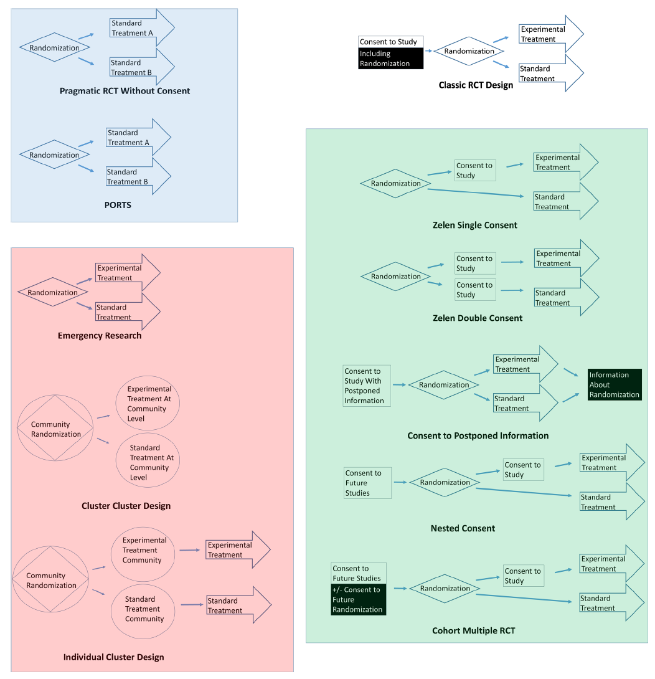

Slide 16
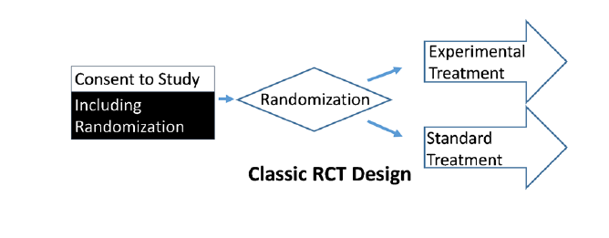

Slide 17
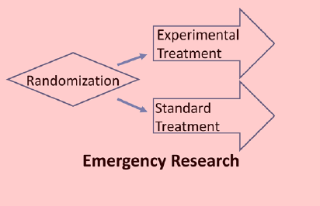

Slide 18
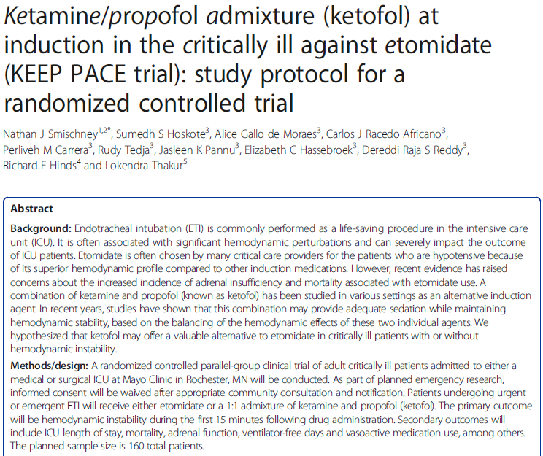

Slide 19
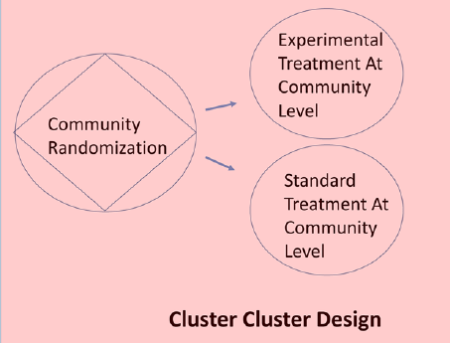
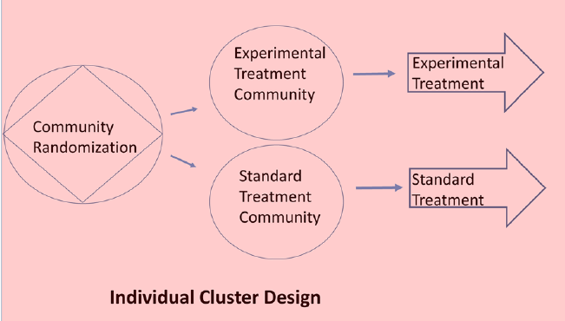
Sim J, Dawson A. Informed consent and cluster-randomized trials. Am J Public Health. 2012 Mar;102(3):480-5.

Slide 20
Cluster Randomized Trials
Cluster-cluster: “On both logical and logistical grounds, individual informed consent is difficult if not impossible in a cluster-cluster randomized trial”
Examples: lead abatement
Cluster-individual: While possible, individual consent would be “deemed incompatible with the methodological integrity of the study”
Examples: varying antihypertensive use by clinic
Community notification and even community-level consent is meant to be a component of cluster-randomized studies
Sim J, Dawson A. Informed consent and cluster-randomized trials. Am J Public Health. 2012 Mar;102(3):480-5.

Slide 21
‘Infeasibility’ Designs
Emergency research and the two flavors of cluster randomized studies are both widely used
Both omit traditional consent based on the argument that it obtaining informed consent is incompatible with doing the study well
This is sometimes a debatable claim
Both include some provisions for alternative modes of consent, such as community notification
How, and whether, such steps are taken varies

Slide 22
‘Infeasibility’ Designs
By far the most widely used forms of RWOC

Slide 24
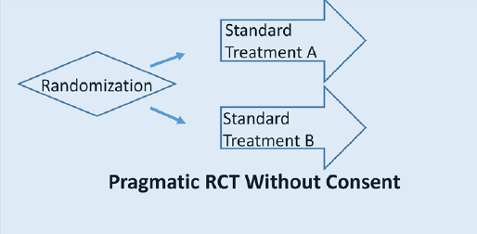

Slide 25
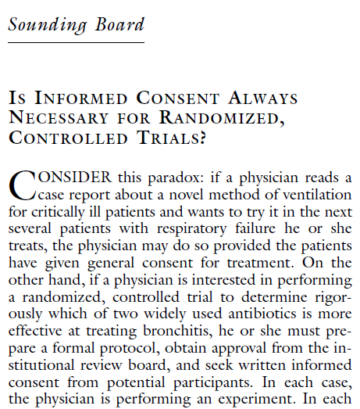

Slide 28
Pragmatic RCTs Without Consent
No claim that informed consent is impossible
Argument that large volume of safe, useful research is not taking place due to inconvenience and cost
Very strong assurance of safety and equipoise
Still almost never done. Why?
Usually not allowed in the US, unless a case for infeasibility can be made

Slide 29
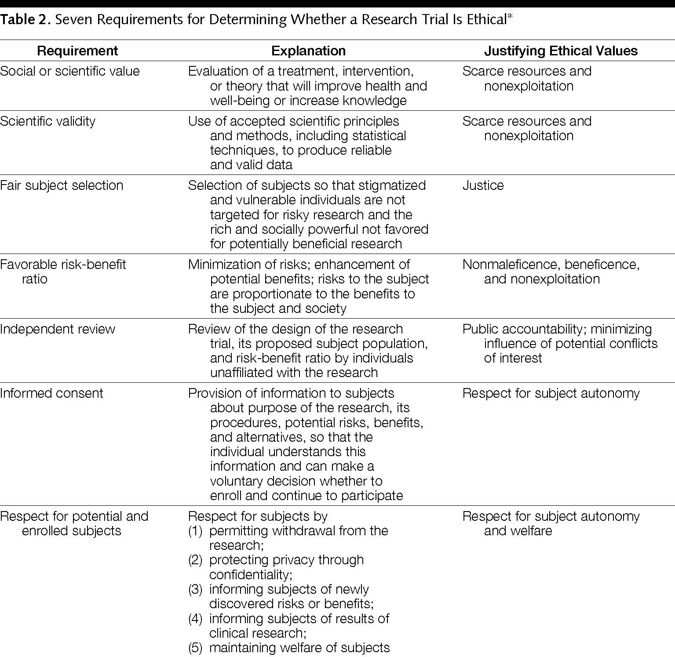

Slide 30
How do patients feel about being put in low-risk research without consent?
Not great

Slide 31
How do patients feel about being put in low-risk research without consent?
For a CER trial comparing antihypertensives, 70% liked opt-in, 65% liked opt-out, and 40% liked general consent
In a survey of attitudes towards EHR research, 91% of respondents expected to be explicitly asked for consent for their identifiable records to be accessed for health provision, research or planning
Some evidence that deliberation and greater levels of information might alter patient attitudes, increasing acceptability of general consent approaches
Kelley M, James C, Alessi Kraft S, et al. Patient Perspectives on the Learning Health System: The Importance of Trust and Shared Decision Making. Am J Bioeth. 2015;15(9):4-17.
Riordan F, Papoutsi C, Reed JE, et al. Patient and public attitudes towards informed consent models and levels of awareness of Electronic Health Records in the UK. Int J Med Inform. 2015 Apr;84(4):237-47.

Slide 32
How do patients feel about being put in low-risk research without consent?
 | Medical Record Review | Randomization (Hypertension) | Randomization (Serious Condition)
“If you were newly diagnosed with high blood pressure and this research were happening in your health system, how would you prefer to be notified about this research?”
No notification | 109 (10.0) | 71 (6.5) | 61 (5.6)
General information | 162 (14.8) | 212 (19.4) | 153 (14.0)
Discussion plus verbal permission | 266 (24.2) | 295 (26.9) | 307 (28.0)
Discussion plus written permission | 558 (51.0) | 517 (47.2) | 574 (52.4)
Cho MK, Magnus D, Constantine M, et al. Attitudes Toward Risk and Informed Consent for Research on Medical Practices: A Cross-sectional Survey. Ann Intern Med. 2015 May 19;162(10):690-6.

Slide 33
Lessons From Pragmatic RCTs Without Consent
Rhetoric about ‘harm from studies not getting done’ is not the same as an infeasibility waiver
Extremely good control of risk is not enough to justify not getting consent
Autonomy is a key consideration
The need to respect autonomy interacts in important ways with ‘learning health system’ concepts
Values of health care researchers and general population are at least superficially out of step

Slide 34
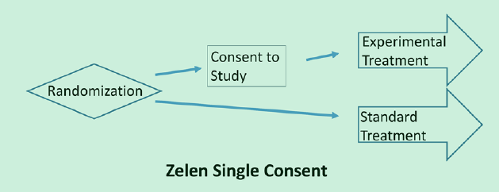

Slide 35
Zelen Single-Consent Design
Used over 20 times
Relies on multiple rationales
Improving feasibility
Improving recruitment
Sparing patients distress from consent discussion when they will not receive the intervention of interest
Aims to preserve physician-patient relationship
"The physician need not leave himself open, in the eyes of the patient, to not knowing what he is doing and ‘tossing a coin’”
Became largely impractical after regulatory changes requiring participants in research to know that they are in research

Slide 36
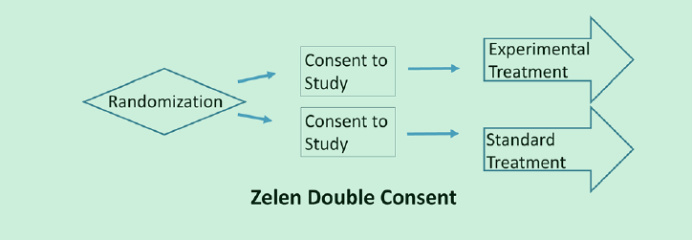

Slide 37
Zelen Designs in Review
Together, single- and double- consent used over 50 times
Reasons for use
Prevention of contamination (8)
Simpler consent procedure
Simpler recruitment
Avoiding confusion and distress
Most commonly used in oncology and behavioral health
Schellings R, Kessels AG, ter Riet G, Knottnerus JA, Sturmans F. Randomized consent designs in randomized controlled trials: systematic literature search. Contemp Clin Trials. 2006 Aug;27(4):320-32.

Slide 39
TwiCs nee Cohort Multiple RCT
TwiCs, depending on how it is specified, is either
a variant of a Zelen double consent trial, or
something closer to a conventional RCT with staged consent

Slide 40
Some Concluding Observations
The world accepts trials without consent under infeasibility waivers.
The rigor with which such claims are evaluated varies
The need for community consent, etc may vary
There is precedent for not obtaining informed consent to randomization when patients are just being exposed to usual care.
But such actions attract controversy
But there are high regulatory barriers in some settings to obtaining NO traditional consent to research at all

Slide 41
Arguments in Tension
Why do patients need to give consent to randomization if they are getting ‘usual care’?
It is disrespectful to their autonomy if they do not.
But isn’t it even worse to subject patients to care that isn’t adequately studied?

Slide 42
Arguments in Tension
Why do patients need to give consent to randomization if they are getting ‘usual care’?
It is disrespectful to their autonomy if they do not.
But isn’t it even worse to subject patients to care that isn’t adequately studied?

Slide 43
Arguments in Tension
Why do patients need to give consent to randomization if they are getting ‘usual care’?
Is there another way to respect autonomy?
It is disrespectful to their autonomy if they do not.
But isn’t it even worse to subject patients to care that isn’t adequately studied?

Slide 44
Arguments in Tension
Why do patients need to give consent to randomization if they are getting ‘usual care’?
Is there another way to respect autonomy?
It is disrespectful to their autonomy if they do not.
Is there a way to lower the burden of informed consent?
But isn’t it even worse to subject patients to care that isn’t adequately studied?

Slide 45
Some Concluding Questions
What is the relationship between TwiCs and Zelen designs?
Will TwiCs be as controversial? Why/why not?
What is the relationship between TwiCs and staged consent?
How streamlined can the consents be?
Should the prior consent include consent explicitly to randomization?
What is the relationship between TwiCs and learning healthcare systems?
Is a learning healthcare system a cohort?

