Slide 1
CmRCT in a fragile patient population
Joanne van der Velden, MD, PhD candidate Department of Radiation Oncology
TwiCs symposium November 7th – 8th 2016

Slide 2
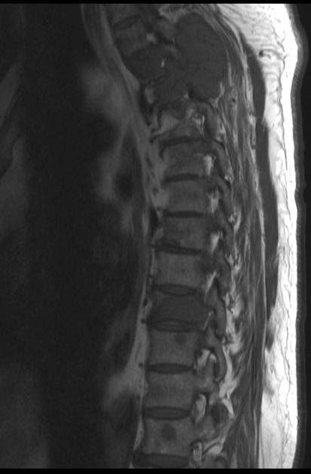
Clinical problem
Many patients with cancer have bone metastases
500 patients at radiotherapy department
Heterogeneous group
Survival range months – years
Treatment goal
reduce pain
improve quality of life
Notes:
Between 30 to70% of the patients with cancer have evidence of bone metastases at autopsy (Falicov 2006).
Heterogeneous group of patients → difficult to manage
Survival ranges from months to several years

Slide 3
PRESENT cohort
PRospective Evaluation of interventional StudiEs on boNe meTastases
All patients with bone metastases who are referred to the departments of radiation oncology or orthopedic surgery at the UMC Utrecht
Endpoints
Pain response & Quality of life
Retreatment
Toxicity
Survival

Slide 4
all PRESENT patients
random selection of eligible patients
eligible patients
information about SBRT treatment
no information about SBRT
accept
refuse
MRI
standard treatment
SBRT
standard follow up
follow up MRI
standard follow up

Slide 5
VERTICAL: study procedure
Cohort clinic
Consultation with radiation oncologist
± offer SBRT
Treatment
Notes:
Elke patient wordt gevraagd
90% doet mee aan cohort, 85% wil gerandomizeerd worden

Slide 6
VERTICAL: study procedure
Cohort clinic
Consultation with radiation oncologist
± offer SBRT
Treatment
Check: pain score
Check: condition
Check: cohort participation
Check: consent to be randomized

Slide 7
VERTICAL flow chart
Randomized n=53
SBRT
n=27
Control
n=26
Eligible
n=21
Eligible
n=22
Accepted
n=16
Treated n=10
Treated n=22
Notes:
Reden van ongeschiktheid Geen pijn 1 Operatie indicatie 1 Laesie buiten WK 2 Ander oorzaak pijn 1 Geen uitstel systemische therapie 1
Reden van weigeren Wilde niet wachten 3 Geen behandeling 2
Reden van uitval Gevallen en conditie ↓ 1 Met spoed conventioneel 2 Geen goede MRI ivm pijn 1 Progressie op beeldvorming 2

Slide 8
VERTICAL flow chart
RECTAL BOOST flow chart
Randomized n=53
Randomized n=64
SBRT
n=27
Control
n=26
Boost
n=31
Control
n=33
Eligible
n=21
Eligible
n=22
Accepted
n=16
Accepted
n=28
Treated n=10
Treated n=22
Treated
n=28
Treated
n=33

Slide 9
VERTICAL
Wrong randomizations
Heterogeneous group with heterogeneous symptoms
No multidisciplinary meetings
Concise referral letters
No recent CT or MRI
Early drop-outs
Due to pragmatic approach

Slide 10
VERTICAL flow chart
RACOST classic RCT
Randomized n=53
Randomized n=11
SBRT
n=27
Control
n=26
SBRT
n=5
Control
n=6
Eligible
n=21
Eligible
n=22
Accepted
n=16
Treated n=10
Treated n=22
Treated
n=5
Treated
n=6

Slide 11
Discussion
Should we continue? Should we stop?
Your experience

Slide 12
Extra slides

Slide 13
PRESENT cohort
Informed consent II
1) Accept the offer of the experimental treatment
Informed consent I
1) Use of routinely collected clinical data
Optionally
2) PROMs
3) Participation in future studies
Cohort multiple Randomized Controlled Trial design, adapted from Relton et al BMJ 2010
Notes:
The ‘cohort multiple Randomized Controlled Trial’ design. A large observational cohort of patients with bone metastases is recruited and their outcomes regularly measured. For a new RCT, information fromthe cohort is used to identify all eligible patients (green box). Eligible patients (larger green box) are randomly selected to undergo the new intervention. The outcomes of these randomly selected patients are then compared with the outcomes ofeligible patients not randomly selected; that is, those receiving usual care. This process can be repeated for further randomised controlled trials (for example, the yellow boxes).
Adapted from Relton 2010.

