Slide 1
What do patients understand of the cmRCT design?
TwiCs symposium, 8th November 2016
Sophie Gerlich, MD

Slide 2

cmRCT @ UMC Utrecht
 | UMBRELLA | PLCRC | PRESENT
 | Breast cancer | Colorectal cancer | Bone metastases
IC cohort | 1512 | 1000 | 868
IC randomization | 87% | 84% | 84%
PROMs return rates | 67-80% | 65-90% | 60-75%

Slide 3

Trials within (UMC) cohorts
PLCRC
RECTAL BOOST: recruiting (64/120)
SPONGE: recruiting (15/188)
PRESENT
VERTICAL: recruiting (58/110)
BLEND: start 2017
UMBRELLA
FIT: recruiting (130/168)

Slide 4
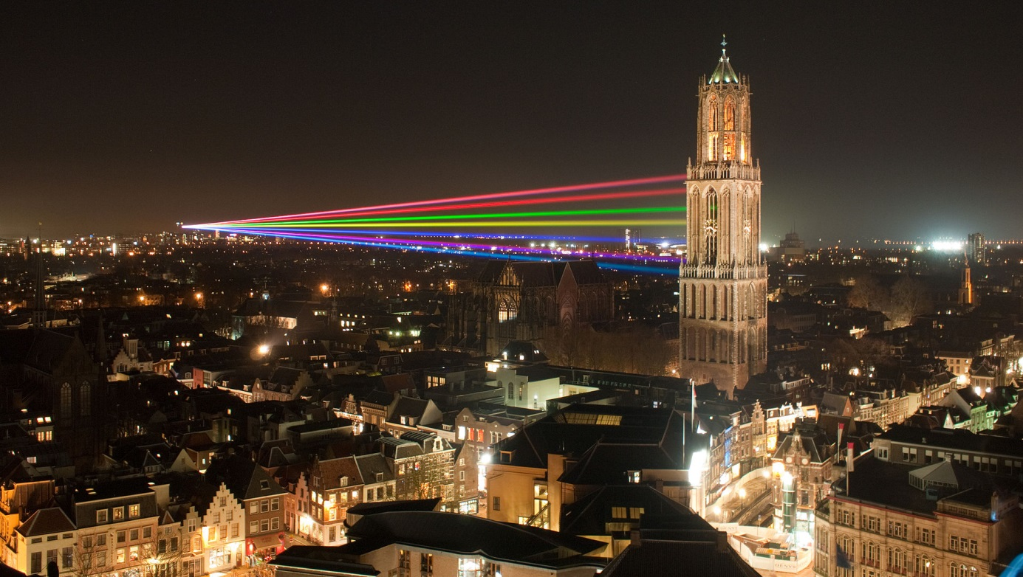
Collaborators
Saskia van Amelsvoort, Maarten Burbach, Rosalie van den Boogaard, Alice Couwenberg, Marijke van Deursen, Sofie Gernaat, Roxanne Gal, Carla van Gils, Madelijn Gregorowitsch, Rolf Groenwold, Cees Haaring, Martijn Intven, Miriam Koopman, Anne May, Tineke Muilenburg, Marianne Oudhof, Marielle Philippens, Clare Relton, Joanne van der Velden, Lenny Verkooijen, Anne Versteeg,
Jorrit-Jan Verlaan, Geraldine Vink, Marco van Vulpen, Danny Young Afat

Slide 5

Do patients understand the IC procedure?
Do patients know they can be randomized into the control arm in a RCT?
  How do they feel about that?
Receive information after trial?

Slide 6

Patients’ perspective

Slide 7
Evaluation with questionnaires
Participation cohort?
Yes
No
Randomization: accept intervention?
Random sample
Yes
No

Slide 8
Evaluation with questionnaires
Participation cohort?
Yes
312
No
84
Randomization: accept intervention?
61
35
Yes
20

Slide 9
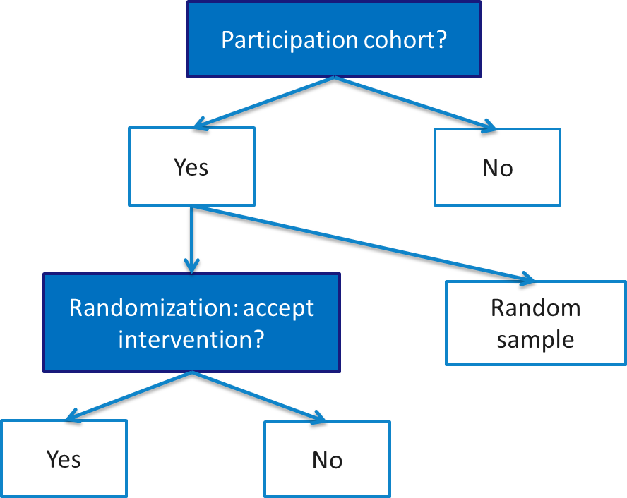
Q: Why participate?
 | YES | NO
UMBRELLA | 162 | 54
PRESENT | 104 | 17
PLCRC | 46 | 13
Total | 312 | 84

Slide 10
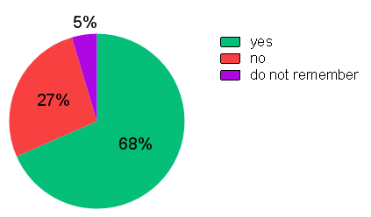
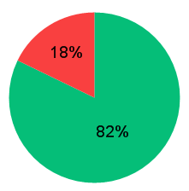
Q: Consent for randomization?
40 patients: thought they did not give permission, but did
10 patients: ˂˃
5%: 13 permission, 1 not

Slide 11
Q: Why no consent for randomization?

Slide 12
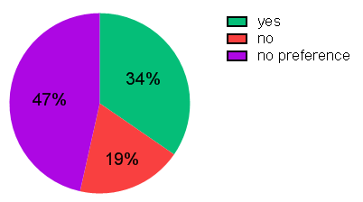
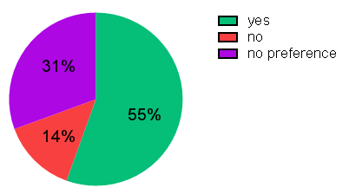
Q: Do you hope to get an invitation for an experimental treatment?
All cohorts
PRESENT

Slide 13
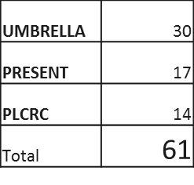
Participation cohort?
Yes
No
Randomization: accept intervention?
Random sample
Yes
No

Slide 14
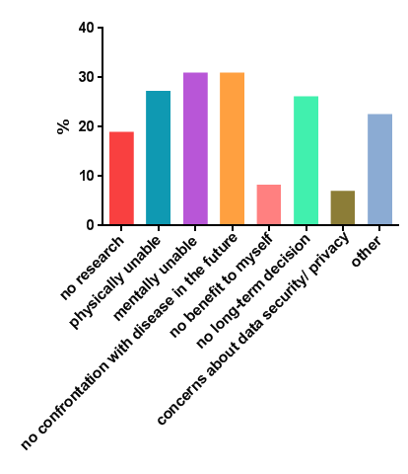
Q: Why no participation?

Slide 15
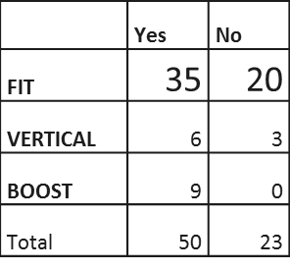
Participation cohort?
Yes
No
Randomization: accept intervention?
Random sample
Yes
No

Slide 16
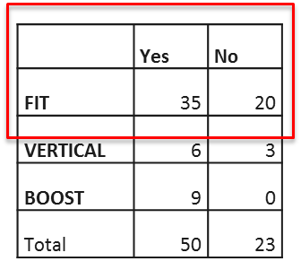
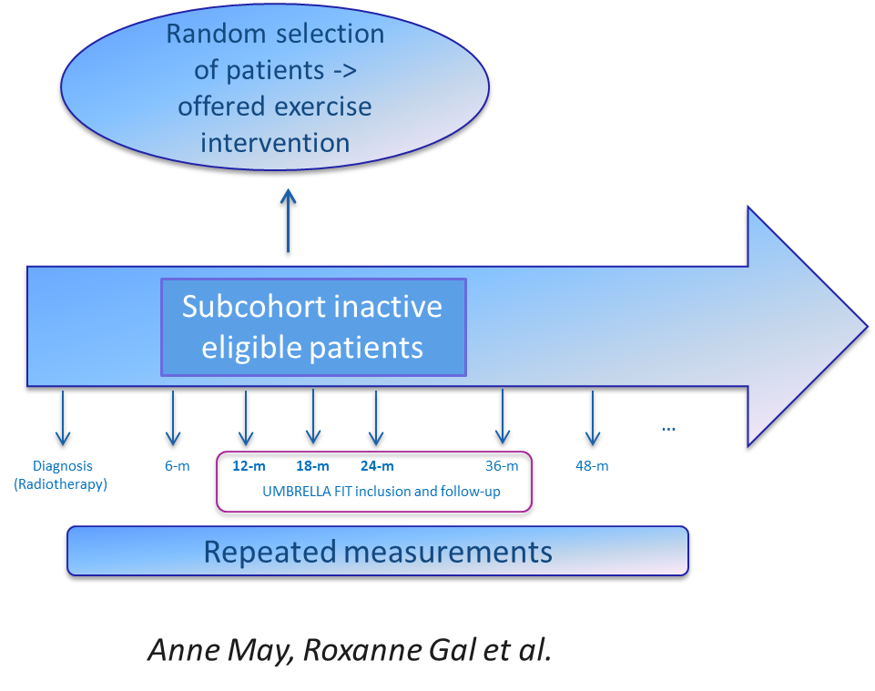

After randomization

Slide 17
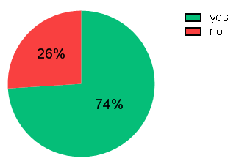
Q: Do you understand there is an association between your consent for participating in UMBRELLA and the invitation for the FIT trial?

Slide 18
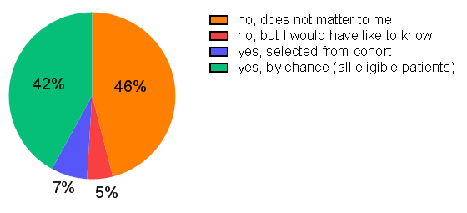
Q: Do you know how you have been selected for this experimental intervention?

Slide 19
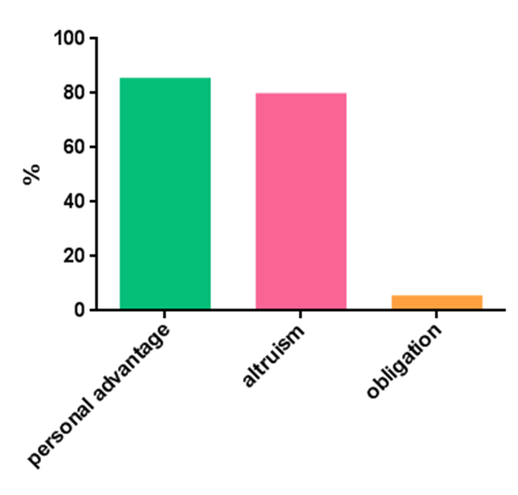
Q: Why did you decide to accept/decline this experimental intervention?
Accept (35)
Decline (20)

Slide 20
Participation cohort?
Yes
No
Randomization: accept intervention?
Random sample
Yes
No

Slide 21
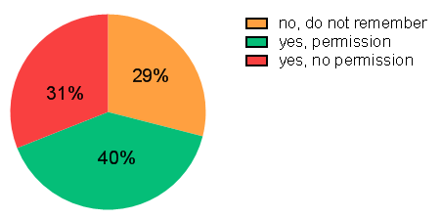
Q: Do you remember whether you gave permission to be invited for future research?

Slide 22
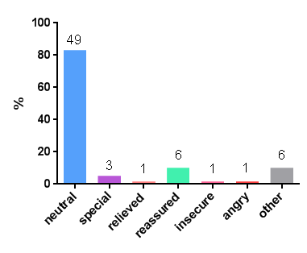
Q: How would you feel if your data was used for comparison to data of patients that underwent an experimental intervention?

Slide 23
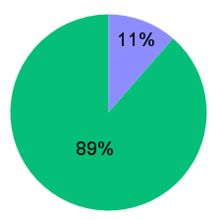
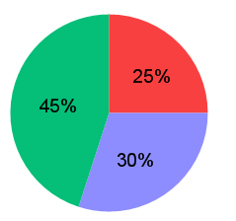
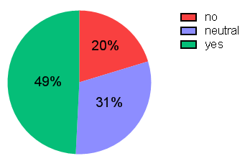
Q: Do you want to receive the results from this experimental intervention?
Accept
Decline
Sample

Slide 24
Conclusion
Not all patients remember if they gave permission for randomization, this number increases over time.
One third of the patients hopes to be invited for an experimental treatment.
Almost half of the patients invited for the FIT trial understands that their selection is based on chance.
The other half does not understand but does not care.
>80% feels neutral about being a control patient

Slide 26
