Slide 1
Patient-reported outcomes in routine care: impact for TWiCs
Andrew Vickers
Memorial Sloan Kettering Cancer Center

Slide 2
Key points
Why take patient-reported outcomes as part of routine care?
How do we do it at MSKCC?
Impact for TWICs

Slide 3
Key points
Why take patient-reported outcomes as part of routine care?
How do we do it at MSKCC?
Impact for TWICs

Slide 4
Chemotherapy patients

Slide 5
Sonn GA, et al. J Urol 2009;182(5):2296–2302

Slide 6

Are you able to get erections that are hard enough for penetration?

Slide 7
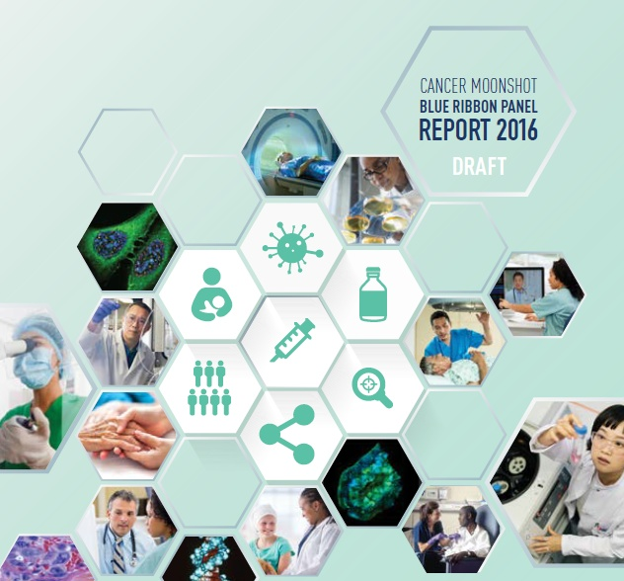

Slide 8
Recommendation F
accelerate the development of systems for the routine monitoring … of patient-reported symptoms across the cancer continuum (from diagnosis throughout survivorship and at end-of-life) as the standard of care for cancer patients in all care settings.

Slide 9
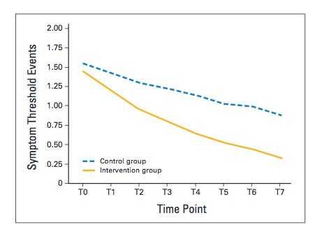
PRO reporting improves symptoms
75% vs. 69% survival at one year (p=0.03)

Slide 10
Key points
Why take patient-reported outcomes as part of routine care?
How do we do it at MSKCC?
Impact for TWICs

Slide 11
From: donotreply@MSKCCSAM.org
To: John.Doe@Email.Net
Subject: Message from Dr Jones
Dear Mr. Doe
I certainly hope that this letter finds you well. I am interested in hearing about how you are doing. I would be very grateful if you could complete the following questionnaire. To start please click here and it will take you to a series of questions about your health.
This information will be automatically entered in our clinical database. I assure you that your information will be kept confidential in accordance with the Health Insurance Portability and Accountability Act (HIPAA) of 1996.
Please be aware that I may not review the information you entered until your upcoming visit. Your responses are stored in the clinical database and will be discussed with you at your next clinic appointment. Should you have any questions about your health or would like to review any of your responses sooner, please telephone my office.
Thank you for your kind cooperation. I believe that your participation will benefit you by helping me to see how you are doing.
Please note that if you select “reply” to these email, your message will go to an unattended Email box. If you have any questions or concerns, please telephone my office.
Sincerely,
Dr Jones MD
Memorial Sloan-Kettering Cancer Center
Note: If you do not wish to receive any further emails from me, you can unsubscribe by clicking here.
MSKCC Questionnaire
MSKCC: Memorial Sloan-Kettering Cancer Center

Slide 12
I certainly hope that this letter finds you well. I am interested in hearing about how you are doing. I would be very grateful if you could complete the following questionnaire. To start please click here and it will take you to a series of questions about your health.
This information will be entered into your clinical record and I will review it before your next appointment.

Slide 13
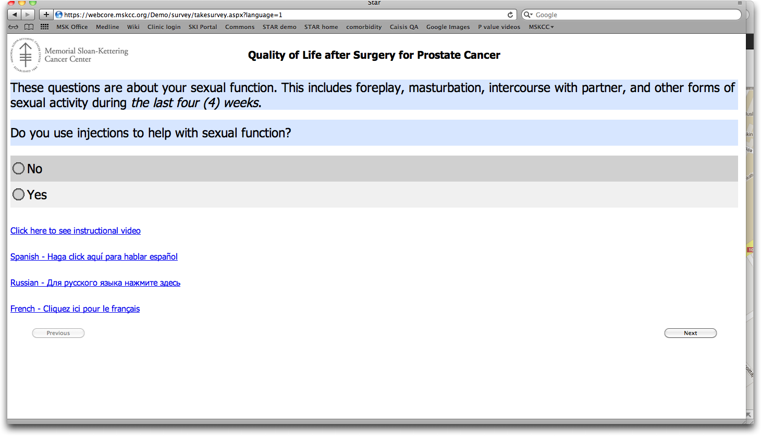

Slide 14
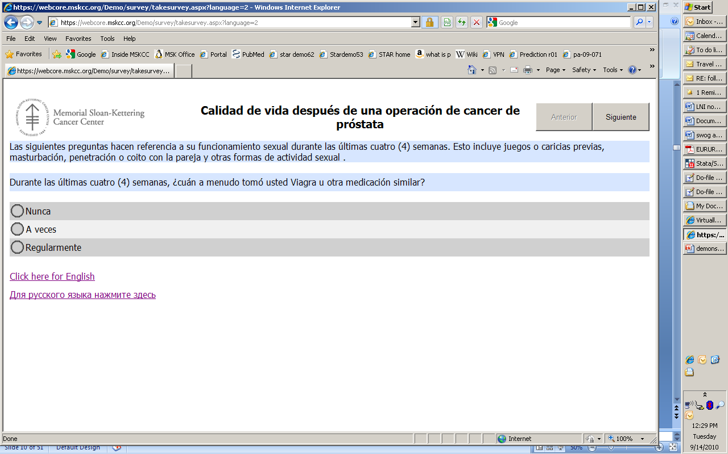

Slide 15
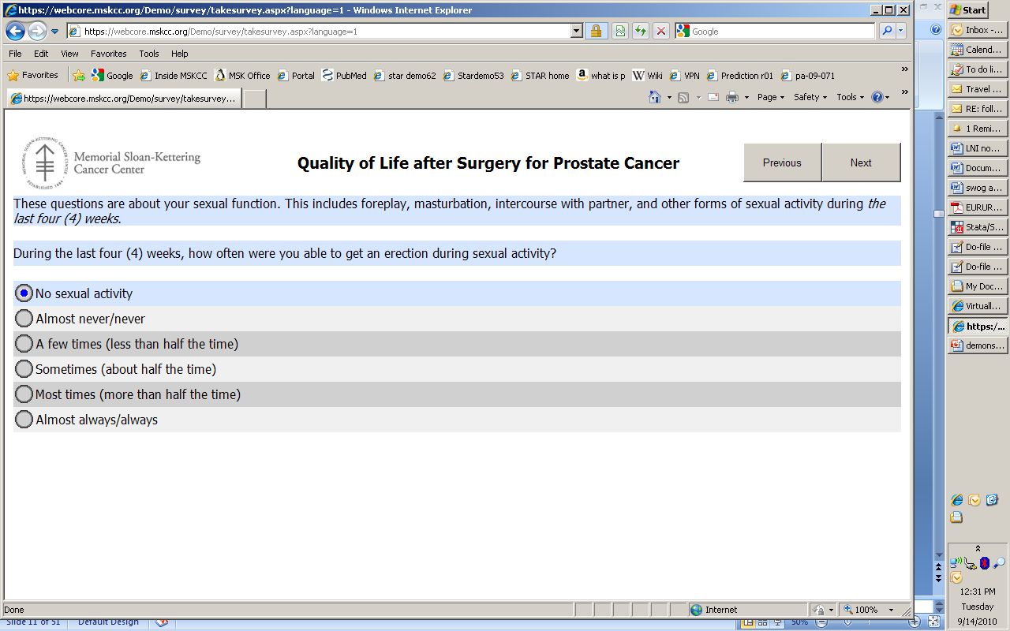

Slide 16
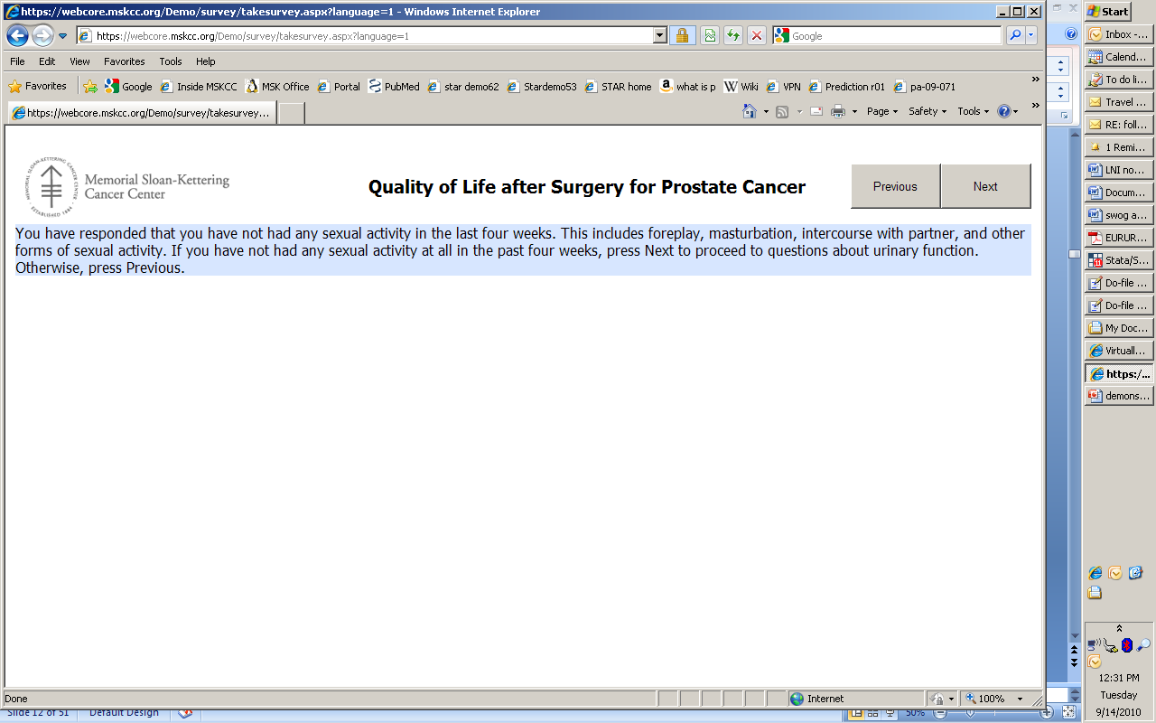

Slide 17
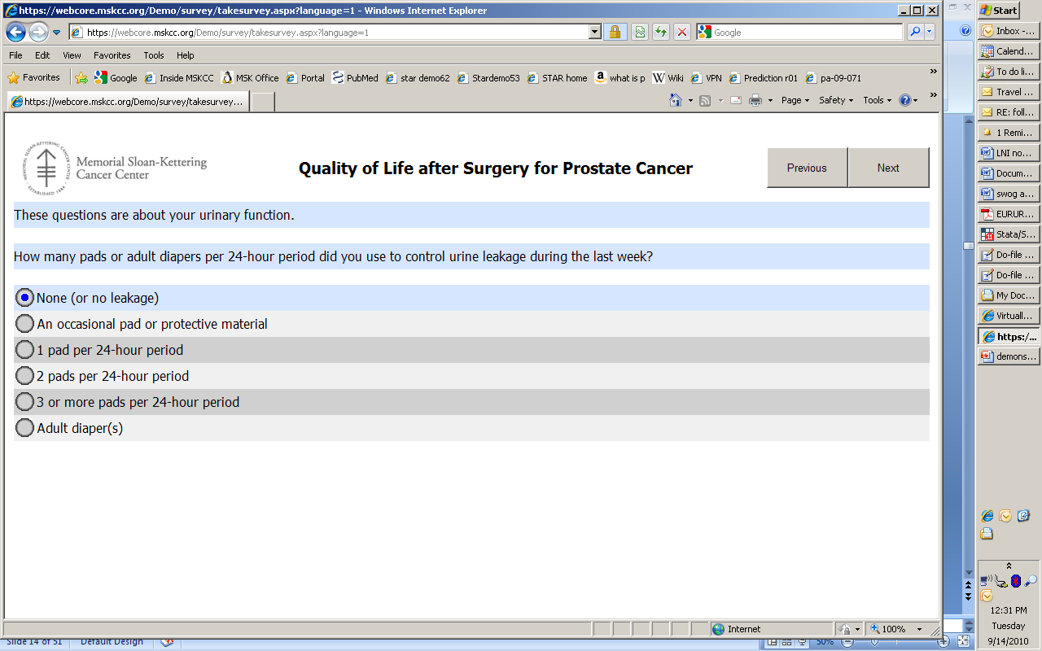

Slide 18
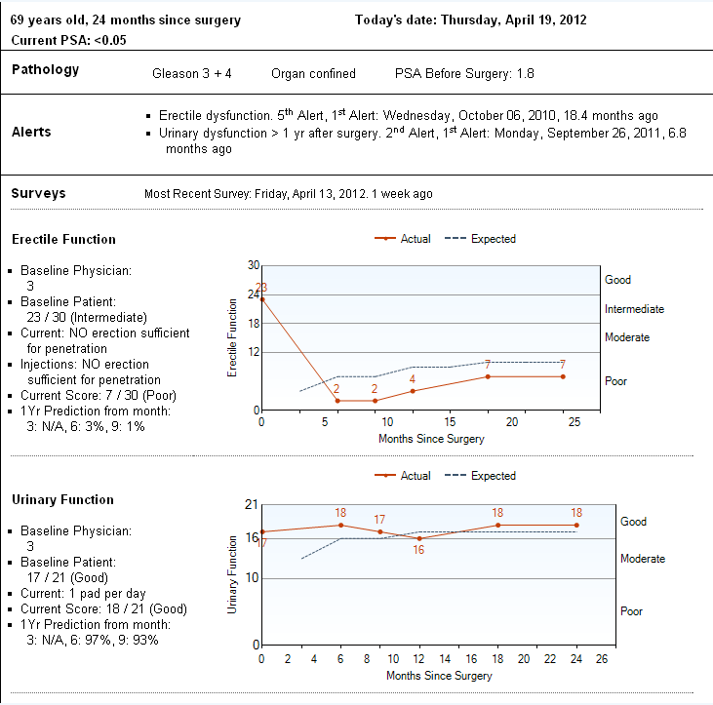

Slide 19
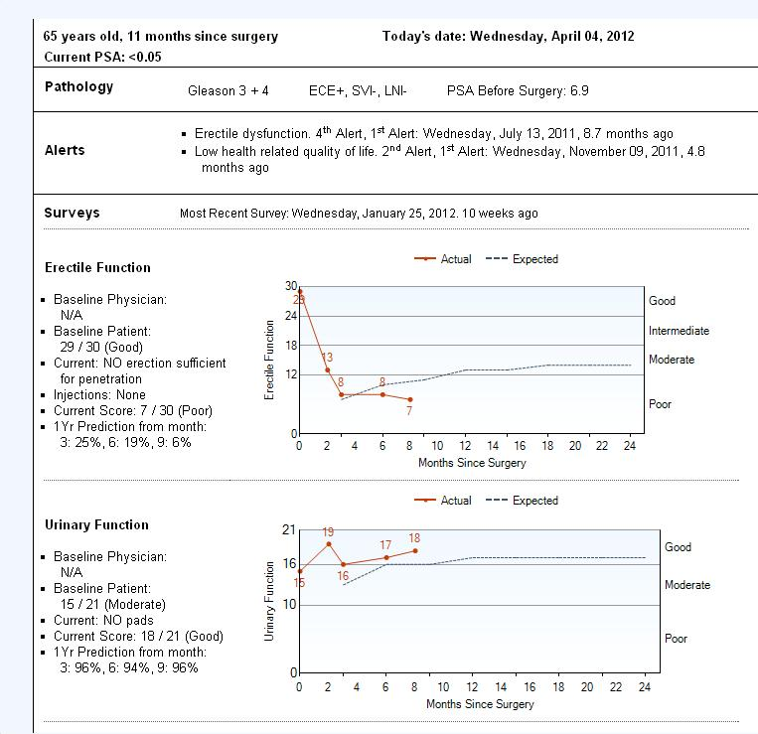

Slide 20
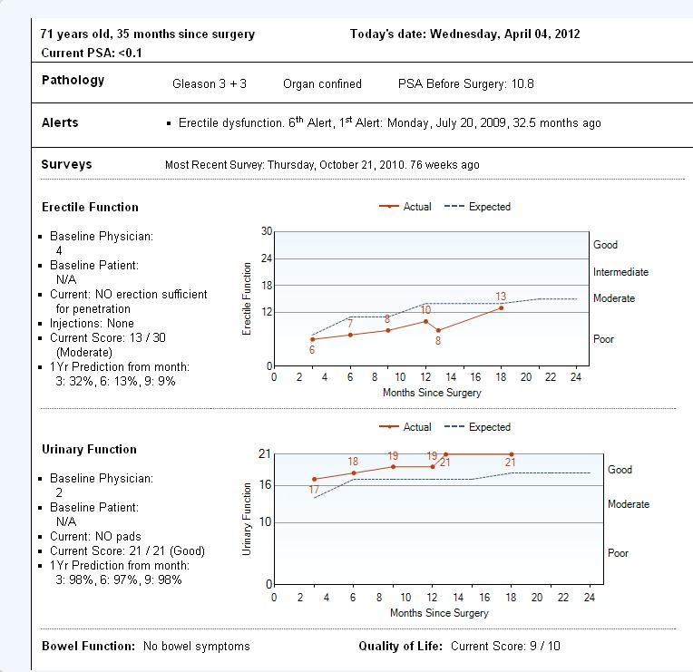
Prediction
Prediction

Slide 21
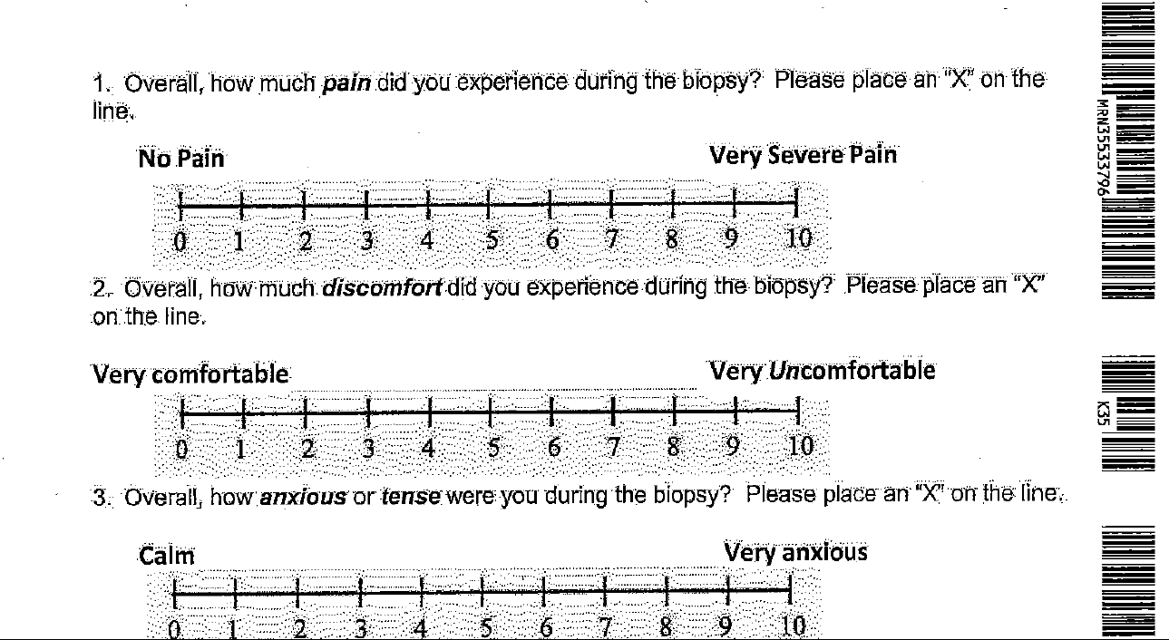

Slide 22
Key points
Why take patient-reported outcomes as part of routine care?
How do we do it at MSKCC?
Impact for TWICs

Slide 23
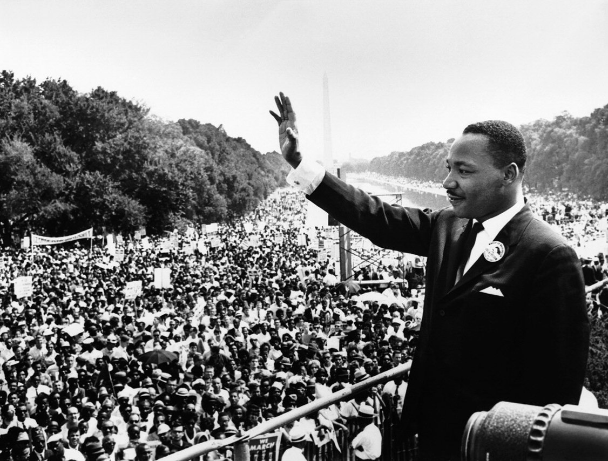
Key concept
Data integration

Slide 24
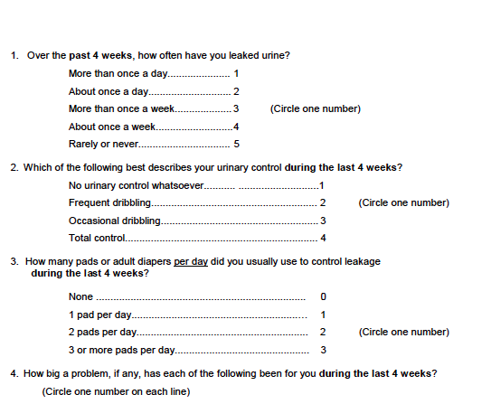


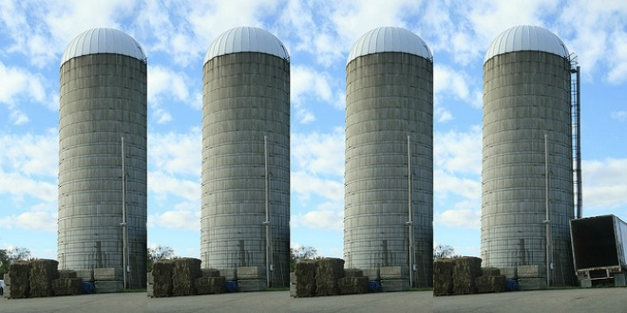
Typical practice
CONFIDENTIAL
Questionnaire for research
Clinician grading for clinical practice
Survey for quality assurance
Data siloing

Slide 25
Data integration
Ask once
  Are you using pads?
Use data for:
  Research
  Clinical practice
  Quality assurance

Slide 26
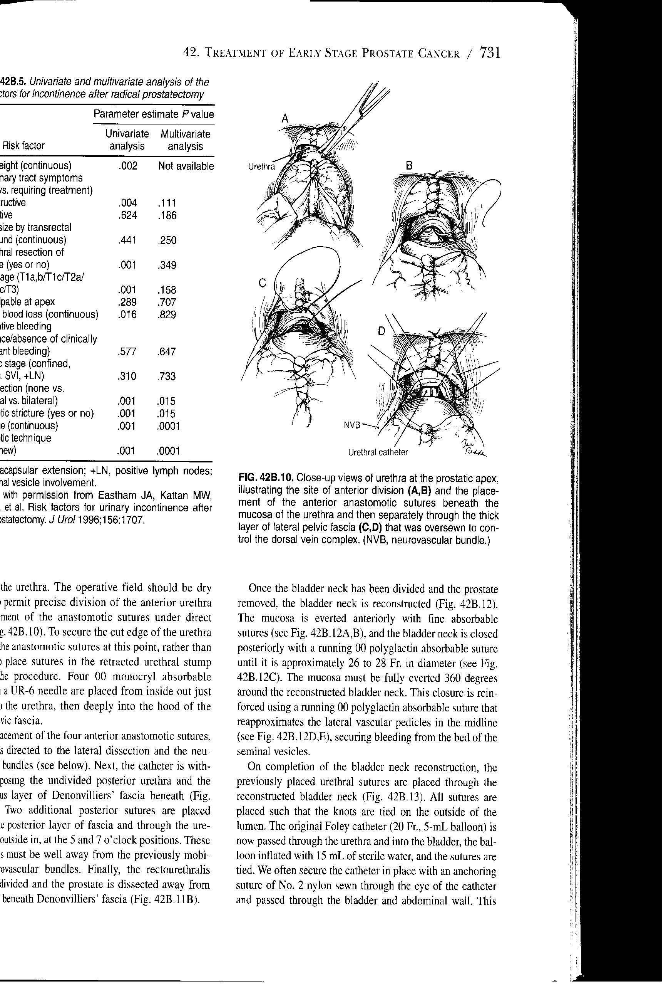
Cluster crossover randomized trial: suturing approaches for bladder anastomosis during prostate surgery

Slide 27
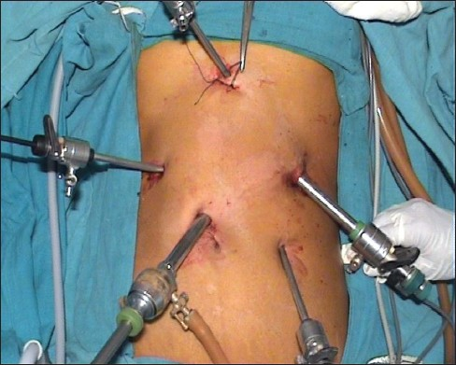
Cluster crossover randomized trial: transverse vs. vertical closure of port-site incision
PHOTO HERE!!!
Picture of endpoint

Slide 28
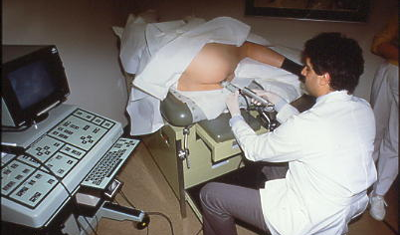
Just-in-time consent of relaxation therapy for prostate biopsy pain

Slide 29
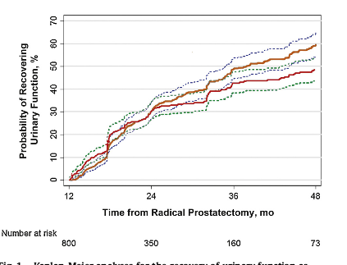
Clinical PROs re-used for observational research

Slide 30
Conclusions
Integrate PROs into routine clinical practice
Focus on optimizing clinical care
  Clinicians must read patient responses
  Patients must complete surveys
  Add value with smart reports
Data available as endpoints for observational and experimental research

