Slide 1
Patient distress and informed consent
Andrew Vickers
Memorial Sloan Kettering Cancer Center

Slide 2
Key points
The issue of framing
Harm from standard informed consent
Can harm be used to motivate TWICs approaches?

Slide 3
Framing can alter response

Slide 4
We’ve been framing TWICs in terms of benefits for researchers
Picture of selfish person

Slide 5
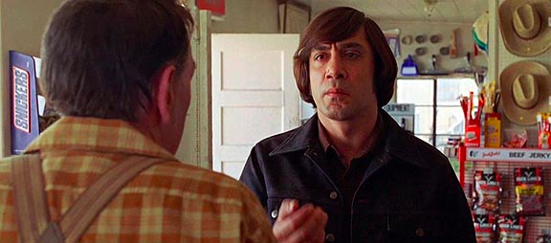
Life and death by the flip of a coin

Slide 6
MSKCC protocol 07 041

Slide 7
17 page informed consent

Slide 10
Decisions lead to
Burden
Conflict
Anxiety
Regret
Confusion
Disappointment
Overload

Slide 12
Effect of TWiCs
Burden: reduced by 50%.
Conflict: reduced by 50%.
Anxiety: reduced by 50%.
Regret: reduced by 50%.
Confusion: eliminated
Disappointment: eliminated
Overload: reduced by 50%.

Slide 13
Empirical data on consent related distress is sparse

Slide 14
Some evidence that anxiety levels are very high in patients undergoing consent

Slide 15
Documenting distress from standard consent
Focus group with patients who had been approached for consent in a trial
Design survey instrument
Evaluate properties of the instrument

Slide 16
Key points
The issue of framing
Harm from standard informed consent
Can harm be used to motivate TWICs approaches?

Slide 17
Reducing harm should be an ethical imperative
For medical and research ethics: autonomy zealotry
Information overload vs. moderate payment as coercion

