Slide 1
Ethics of TwiCs (Trials within Cohorts): International Symposium
7-8th November, London, UK
Notes:
Welcome – introduce self & Jon & audience
Thank funders
Fantastic line up of speakers and a great diverse audience – people from UK, France, Netherlands, Norway, Canada and the USA – triallists, trial methodologists, bioethicists, regulators
Wellcome Trust grant: “This symposium will help pave the way forward for healthcare/research informed consent procedures which are ethical and acceptable. This approach (if broadly adopted) would enable publicly funded healthcare systems to quickly and efficiently recruit patients to pragmatic trials and transition to learning healthcare systems, integrating research and health”
Filming/ mikes/ questions
Outputs - videos
- www.twics.global
– Trials – (BMC stable) supplement department – a meeting report or meeting abstracts
Housekeeping

Slide 2
Proposal 1 The Informed Consent Trial: a randomised controlled trial of the efficiency and acceptability of two different Informed Consent pathways for effectiveness trials with ‘usual care’ comparators
Clare Relton

Slide 3
Aim: to compare the efficiency and acceptability of two different Informed Consent pathways (Standard vs Tailored) for effectiveness trials with ‘usual care’ comparators.
Objectives:
To conduct a randomised controlled trial comparing the ‘Standard’ and ‘Tailored’ pathways for Informed Consent
To compare the efficiency of each pathway (Standard vs Tailored) to Informed Consent (IC), where efficiency is measured by the following ratios: numbers analysed to the numbers approached; numbers analysed to numbers randomised; numbers analysed to numbers allocated to the intervention; numbers who comply/ accept their allocation. Efficiency will also be measured by comparing: time taken and cost incurred for each stage of the trial as well as the comparability of the characteristics of those recruited (age, gender, deprivation, co-morbidities) with regards to the population to whom the results will be generalised
To obtain the views of key stakeholders (public, clinicians and researchers) as to the acceptability of each pathway to Informed Consent.

Slide 4
Proposal 2 Introducing reporting of Informed Consent to trials: an extension to the CONSORT Statement
Clare Relton

Slide 6
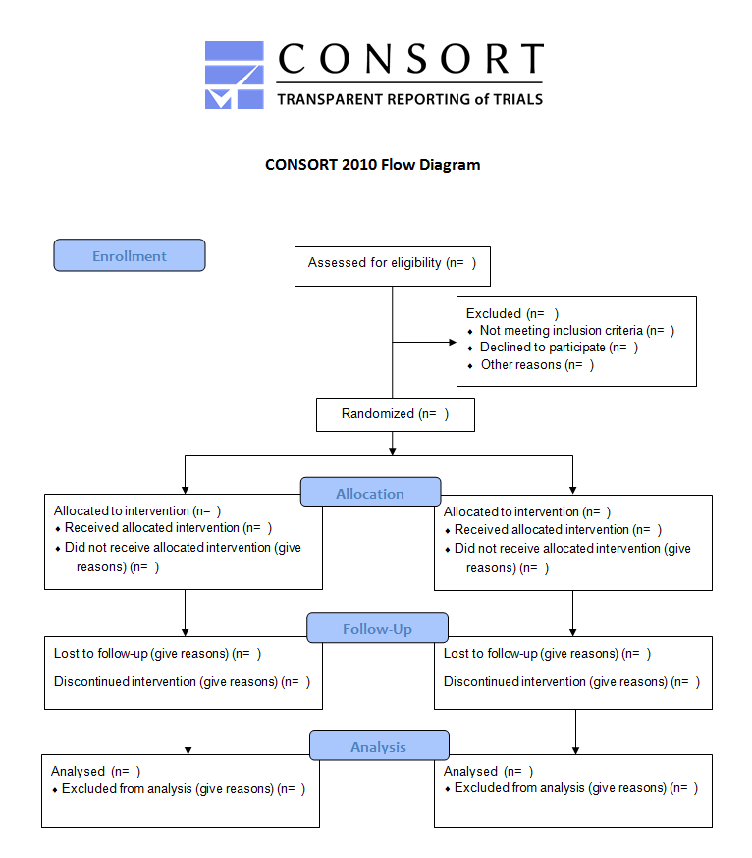
Language 3
TwiCs and CONSORT

Slide 7
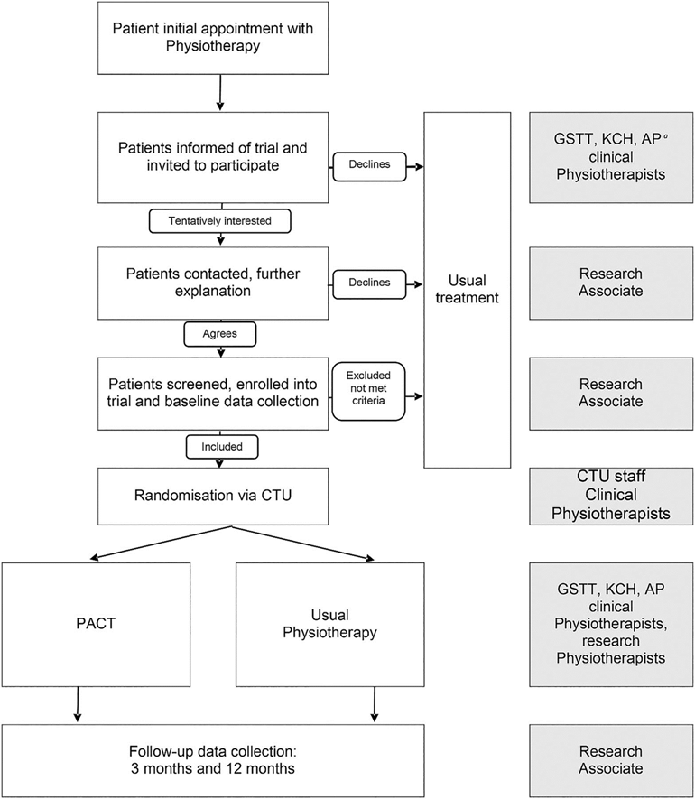
Language 3
TwiCs and CONSORT

Slide 8
Proposal 3 TwiCs in prevention research (CRUK-Population Research Committee)
Clare Relton

Slide 9
Explore the potential of TwiCs approach to transform healthcare systems into learning healthcare environments
CRUK interest from Population Research Committee
Linking up existing cohorts/ building UK national cohort – and using this to test preventative interventions – behaviour change etc

Slide 10
Proposal TwiCs in LMICs GCRF methodology funding
Clare Relton

