Slide 1
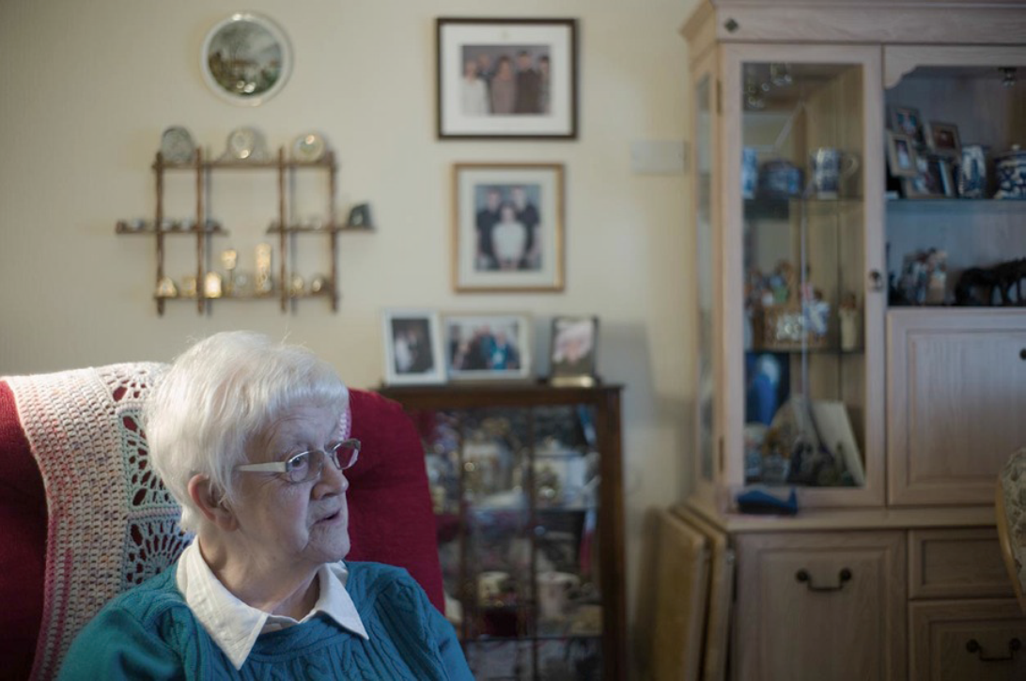
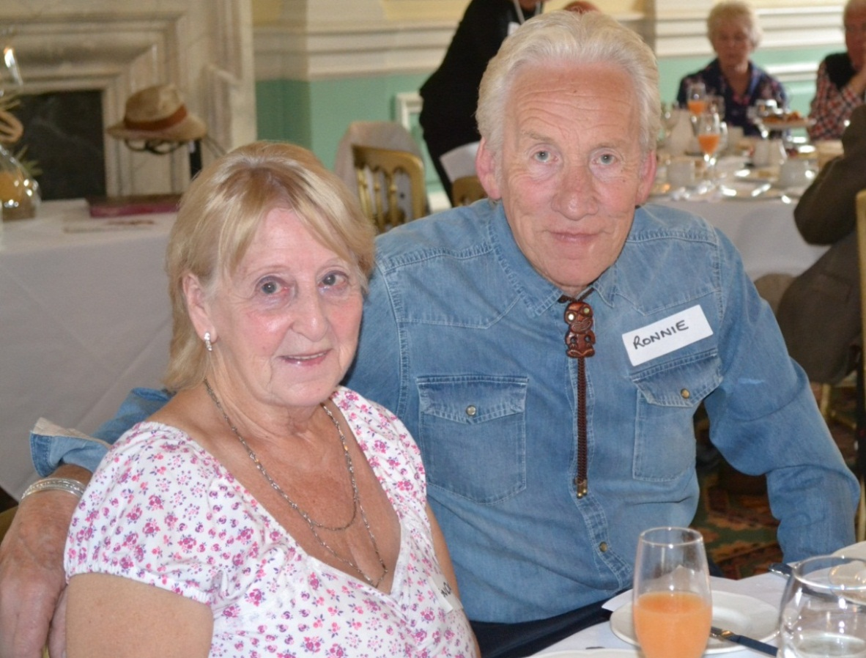
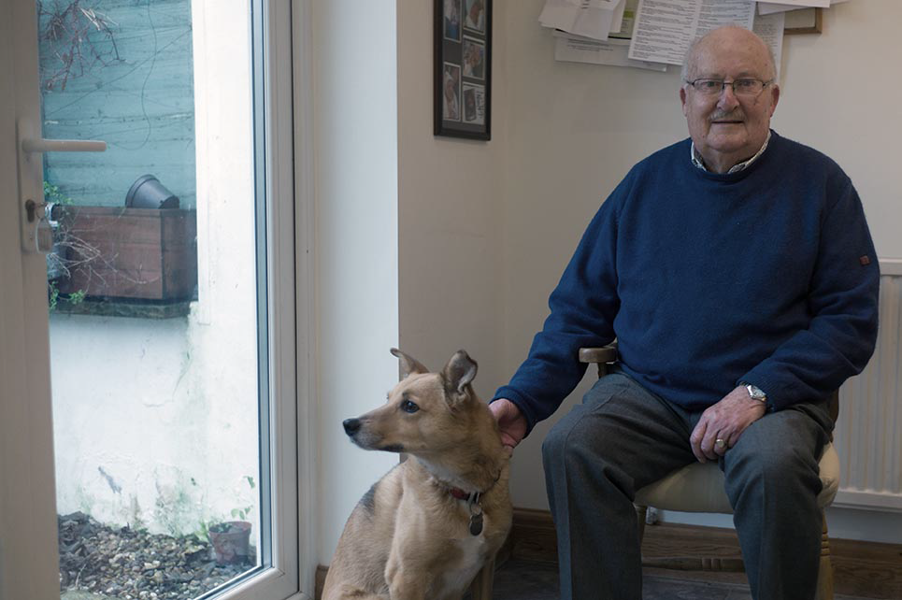
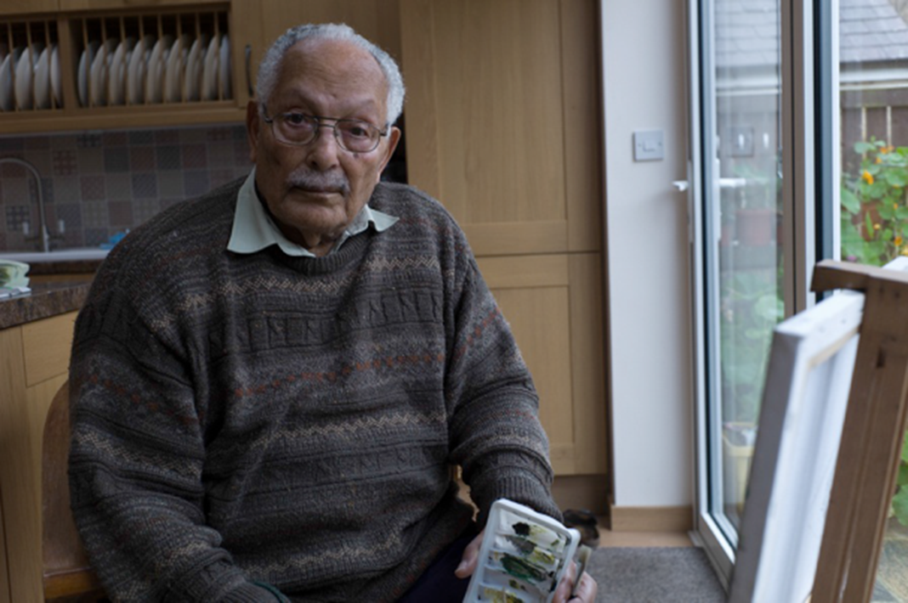
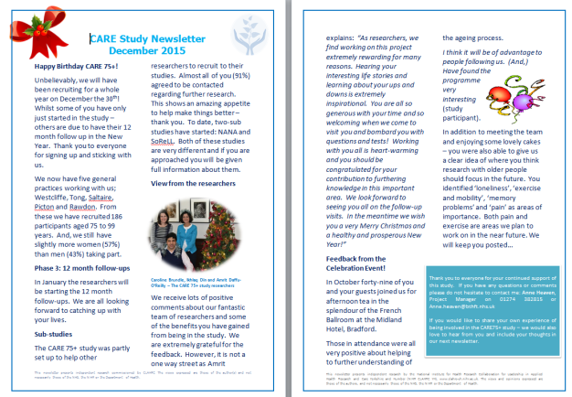
The Importance of oversight in Trials within Cohorts (TwiCs ): experiences from the Community Ageing Research 75+ (CARE 75+) study
Lesley Brown^{1*}, Anne Heaven¹, John Young¹, ², Andrew Clegg¹,²
¹Bradford Institute for Health Research, Bradford Teaching Hospitals NHS Foundation Trust; ²Academic Unit of Elderly Care and Rehabilitation, University of Leeds
*Correspondence to: L.Brown. Tel: (+44) 01274 383906; Email: lesley.brown@bthft.nhs.uk
Contact. Lesley.Brown@bthft.nhs.uk
Introduction
The Community Ageing Research 75+ (CARE 75+) study is using a TwiCs design to build ageing and frailty research capacity as part of the NIHR Collaboration for Leadership in Applied Health Research and Care, Yorkshire & Humber (NIHR CLAHRC Y&H). CARE 75+ is recruiting community-dwelling older people (>75years) from GP practices across the UK.
CARE 75+ captures health, social and economic data and is a platform for qualitative research, feasibility studies and for future intervention trials. There are particular challenges of being involved in multiple studies which have relevance for older populations with problems including frailty, disability and cognitive impairment.
To meet these challenges
We have staggered invitations so participants are not receiving information about multiple studies at one time point.
We have worked alongside our patient and public group, the Frailty Oversight Group (FOG). They have scrutinised potential sub-studies to ensure there is no replication of outcome measures and therefore no unnecessary burden for participants.
The FOG have observed researchers undertaking consent and assessments and provided feedback to improve the process.
We continue to work with our patient and public group to improve branding of information sheets and consent forms to ensure clarity and discrimination between CARE 75+ and sub-studies.
We provide regular communications via newsletters to inform of new up-and-coming studies
The challenges
Initial consent procedure into the cohort is complex as researchers need to explain about potential requests for future study participation, about control data and data linkage.
Our experience indicates additional challenges when sub-studies start recruiting including the potential confusion between participant involvement in CARE75+ and involvement in the sub-studies: participants not recognising the discreet nature of the different studies.
Excessive approaches for participation in sub-studies may reduce retention rates for the cohort if participants become fed up with requests and drop out.
The research was funded by the CLAHRC Yorkshire and Humber. The views expressed are the views of the authors and not necessarily those of the NHS, the NIHR or the Department of Health

